Slide 1
Biološki biljezi Alzheimerove bolesti
14. studeni 2018.
Klinički zavod za laboratorijsku dijagnostiku
Klinički bolnički centar Zagreb
Prof. dr. sc. Goran Šimić, dr. med.
Redoviti profesor neuroznanosti i anatomije čovjeka
u trajnom zvanju
Zavod za neuroznanost
Hrvatski institut za istraživanje mozga, Šalata 12
Medicinski fakultet Sveučilišta u Zagrebu
ZAGREB 10000, REPUBLIKA HRVATSKA
Hrvatska zaklada za znanost
Projekt IP-2014-09-9730 (2015-2019)
Croatian Science Foundation

Slide 2
Rano otkrivanje uzroka demencije
Smisao ranog otkrivanja uzroka demencije jest u tome da se bolest zaustavi u što ranijem stadiju tj. prije nastupa nepopravljivih oštećenja mozga i posljedičnog gubitka mentalnih sposobnosti. Najprije treba isključiti reverzibilne uzroke demencije!
Najvažnija strategija za ostvarenje tog cilja je iznalaženje bioloških biljega (biomarkera) kojima bi se što ranije i pouzdanije otkrilo patološki proces, po mogućnosti i prije nastupa kliničkih simptoma i znakova bolesti (pretklinički/prodromalni stadij).
Da bi se neki biomarker odobrio za uporabu u kliničkoj praksi najprije mora proći postupak validacije kroz veći broj multicentričnih istraživanja na velikom broju ispitanika.

Slide 3
Reverzibilni uzroci demencije
„Neurokirurška” stanja | Infekcije | Metabolički uzroci | Ostali uzroci
subduralni hematom ili empijem | meningitis (TBC, gljivični, itd.) | hipotireoza | depresija (pseudodemencija)
idiopatski normotenzivni hidrocefalus | encefalitis (HIV, herpes) | Hashimoto encefalitis | epilepsija
Intrakranijalne mase (tumori, apscesi) | cerebralni vaskulitis | hipertireoza | lijekovi (s antikolinergičkim učinkom)
 | neurosifilis | hipo- i hiperperatiroidizam | alkoholizam
 | Lajmska bolest (borelioza) | hiperkalcemija | autoimuni encefalitisi
 | sarkoidoza | Cushingova bolest | paraneoplastički sy
 |  | Addisonova bolest
 |  | hipoglikemija
 |  | Deficijencija vitamina B1, B6, B9, B12
 |  | kronična bolest jetre
 |  | kronična plućna bolest
 |  | kronična renalna bolest
 |  | Wilsonova bolest

Slide 4
Reverzibilni uzroci demencije
„Neurokirurška” stanja | Infekcije | Metabolički uzroci | Ostali uzroci
subduralni hematom ili empijem | meningitis (TBC, gljivični, itd.) | hipotireoza | depresija (pseudodemencija)
idiopatski normotenzivni hidrocefalus | encefalitis (HIV, herpes) | Hashimoto encefalitis | epilepsija
Intrakranijalne mase (tumori, apscesi) | cerebralni vaskulitis | hipertireoza | lijekovi (s antikolinergičkim učinkom)
 | neurosifilis | hipo- i hiperperatiroidizam | alkoholizam
 | Lajmska bolest (borelioza) | hiperkalcemija | autoimuni encefalitisi
 | sarkoidoza | Cushingova bolest | paraneoplastički sy
 |  | Addisonova bolest
 |  | hipoglikemija
 |  | Deficijencija vitamina B1, B6, B9, B12
 |  | kronična bolest jetre
 |  | kronična plućna bolest
 |  | kronična renalna bolest
 |  | Wilsonova bolest

Slide 5
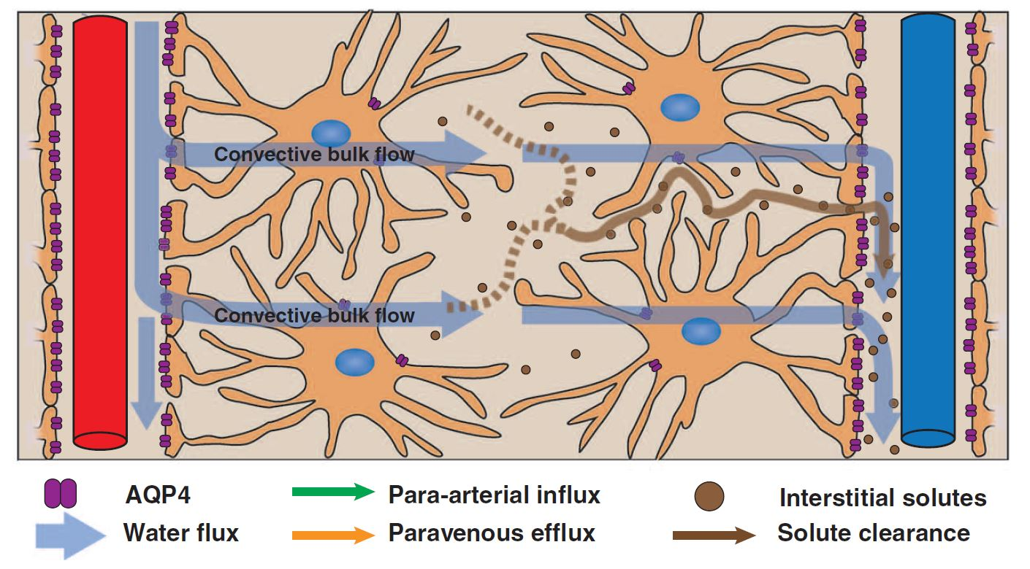
iNPH
AD

Slide 6
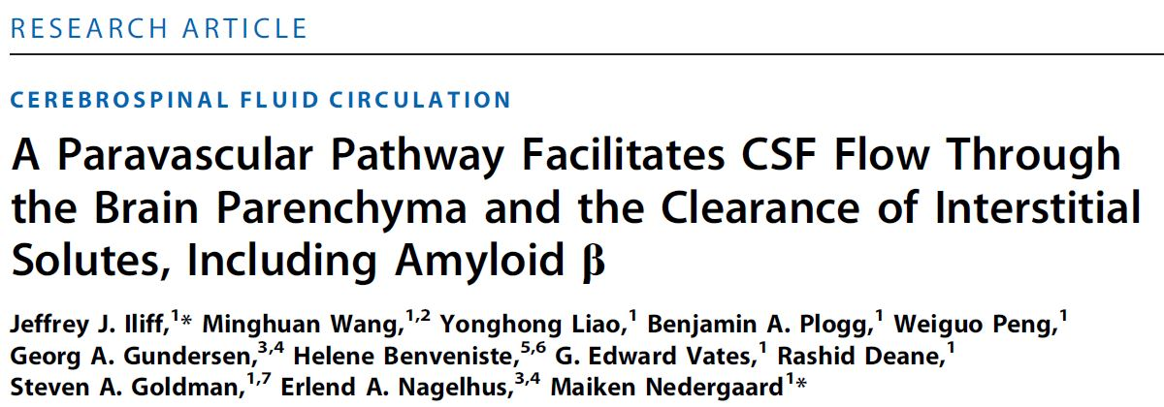
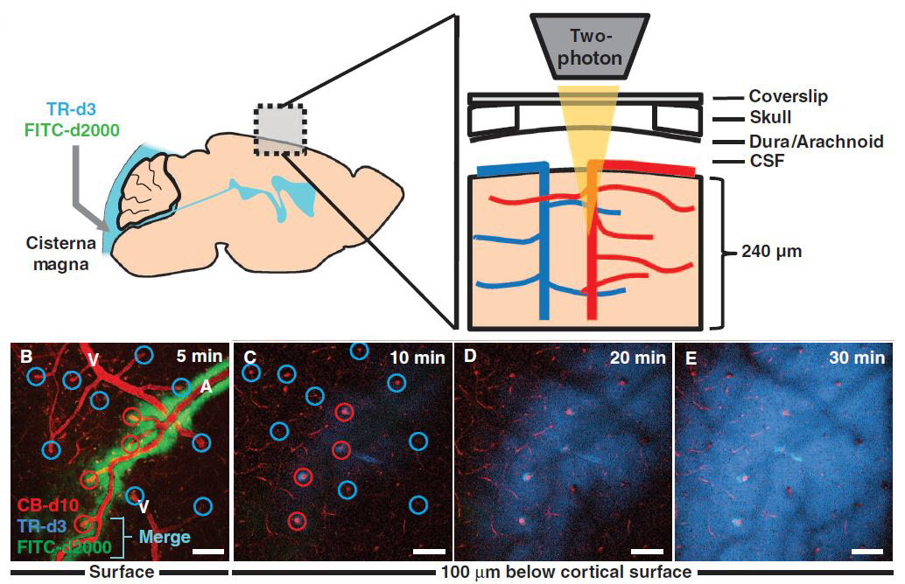
Immediately after intracisternal injection, CSF tracer moved along the along (outside) of cerebral surface penetrating arterioles, but not venules. The small–molecular weight tracer (TR-d3, dark blue) moved readily into the interstitium, whereas the large–molecular weight tracer (FITC-d2000, green) was confined to the paravascular space.

Slide 7
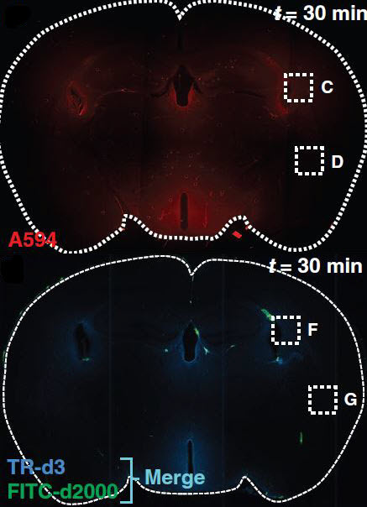
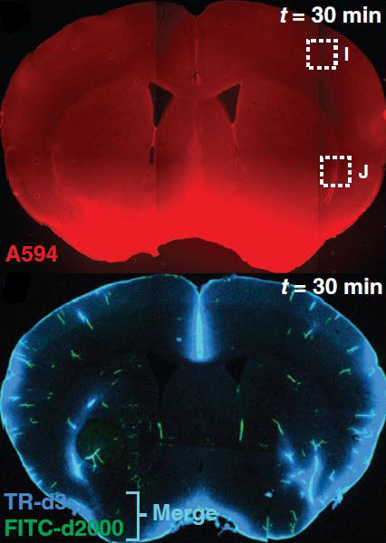
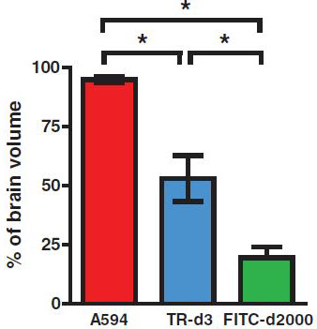
As opposed to ventricular infusion (where there was absence of tracer in tissue remote from the periventricular space), intracisternal injection of tracer depended on its size: after 30 min the smallest A594 occupied the greatest proportion of brain tissue, TR-d3 exhibited an intermediate distribution, whereas large FITC-d2000 was highly restricted.
Ventricular infusion
Intracisternal injection
Distribution of intracisternally injected tracers, quantified as a percentage of total brain volume
absence of tracer in tissue remote from the periventricular space
759
Da
absence of tracer in tissue remote from the periventricular space
3 kDa
2,000
kDa

Slide 8
Glymphatic system

Slide 9
Maiken Nedergaard coined the term „glymphatic system” in recognition of its dependence upon Glial cells and the similarity of its functions to those of the peripheral LYMPHATIC system.

Slide 10
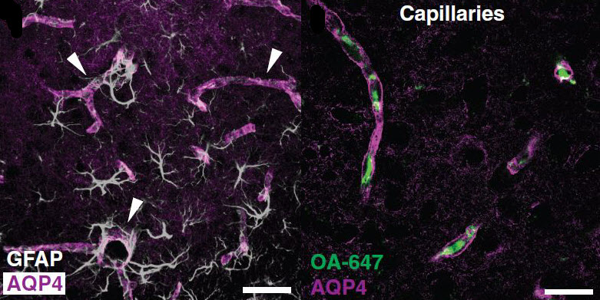
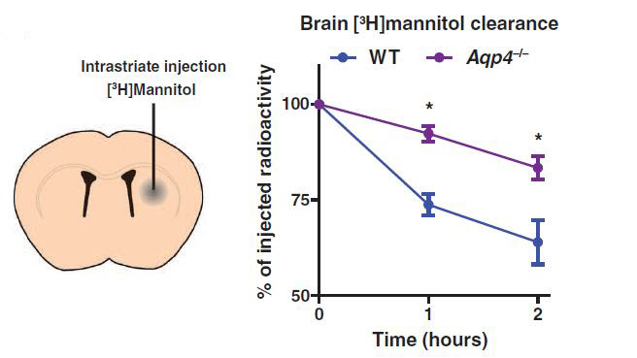
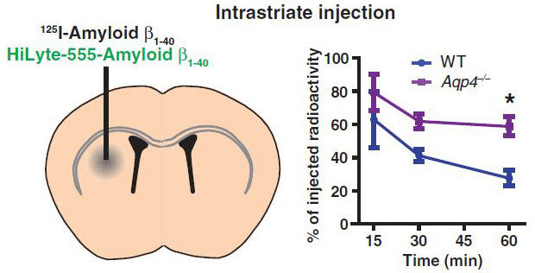
To evaluate the role of glymphatic system in the clearance of interstitial solutes, the elimination of intrastriate ³H-mannitol (182 Da) from the brain was measured in WT and Aqp4-null mice. Over the first 2 h after injection, the clearance of intrastriate ³H-mannitol from Aqp4-null mouse brains was significantly reduced compared to WT.
The same experiment was repeated with intrastriate injection of ¹²⁵I-amyloid β_{1–40} injection, and the whole-brain radiation was measured. After 60 min in WT animals 125I-amyloid β_{1–40} was cleared significantly more rapidly than in Aqp4-null mice.

Slide 11
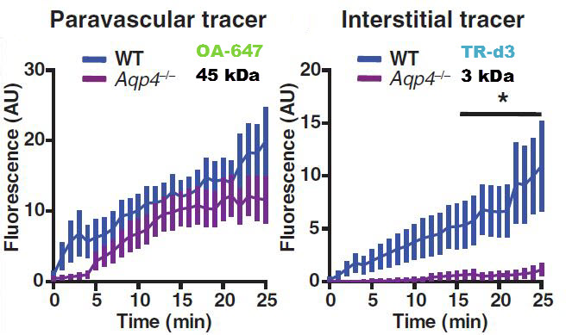
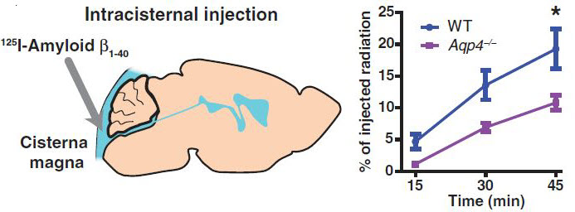
Movement of interstitial tracer was abolished in Aqp4-null mice.
45 kDa, intracisternal injection
To evaluate whether soluble amyloid β within the CSF could recycle through the brain parenchyma, ¹²⁵I-amyloid β_{1–40} was injected intracisternally: compared to WT controls,
¹²⁵I-amyloid β_{1–40} influx was significantly reduced in Aqp4-null mice.

Slide 12
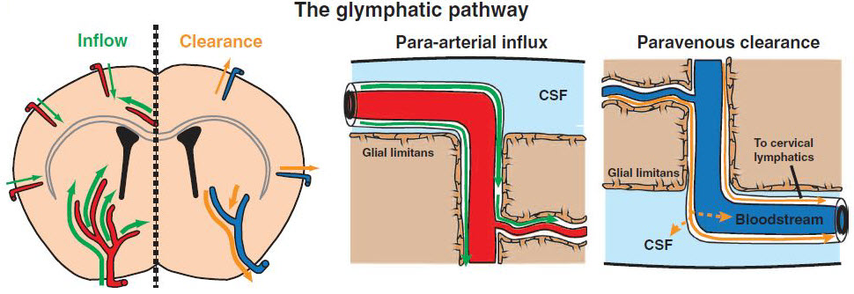
CSF enters the brain along para-arterial routes, whereas
ISF is cleared from the brain along paravenous routes.
iNPH
AD

Slide 13
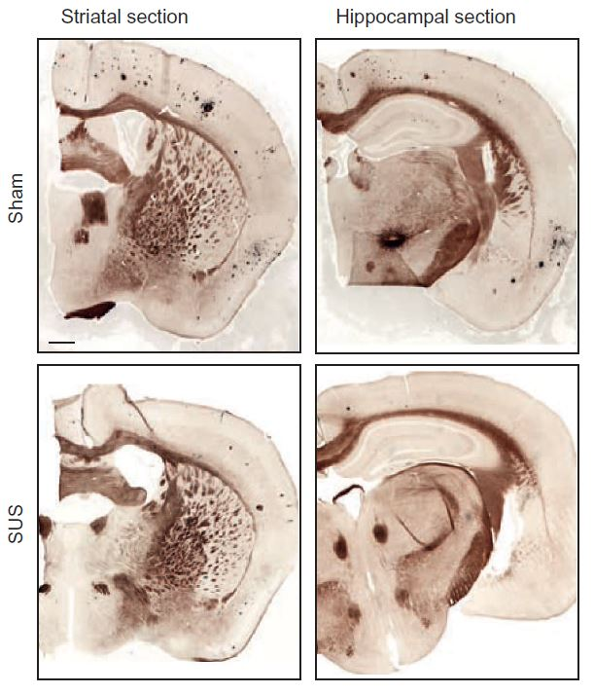
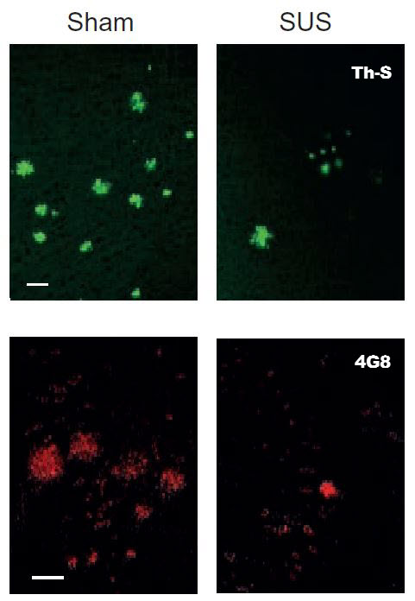
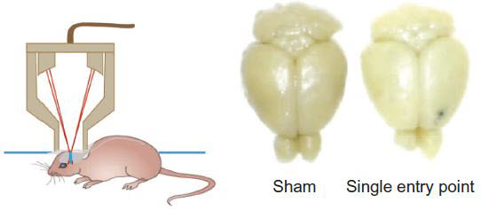
Some potential directions for future therapies of AD
iNPH is practically reversible as about 81% of patients significantly improve after neurosurgical enhancement of the drainage of CSF from the lateral ventricles into the peritoneal cavity by shunt surgery, thus increasing the efficiency of glymphatic paravenous efflux (Luikku et al., Acta Neurochir. 2016; 158: 2311-2319)
- To increase glymphatic system efficiency by local application of scanning ultrasound (SUS)
Sci. Transl. Med. 2015; 278: 1-12.

Slide 14
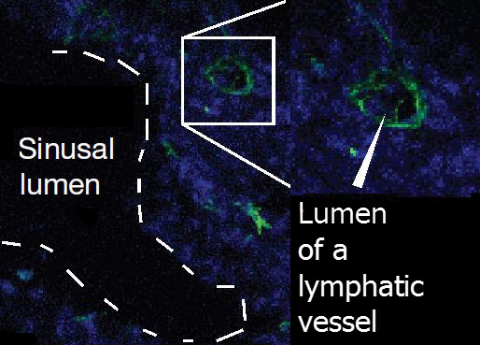
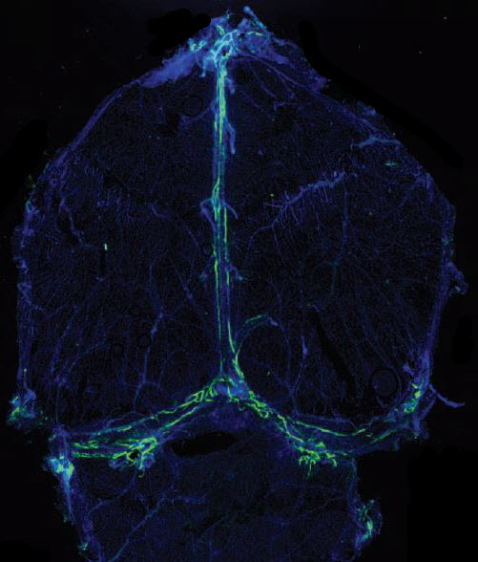
Up until 2015, it has been thought that one of the characteristics of the central nervous system is the lack of a classical lymphatic drainage system.
Using monoclonal antibiodies against LYVE-1 (lymphatic vessel endothelial hyaluronan receptor 1), a cell surface receptor on lymphatic endothelial cells that is used as a lymphatic endothelial cell marker, a group of Jonathan Kipnis et al. (Charlottesville, Virginia) described functional lympathic vessels lining the dural sinuses in the mouse brain.
Superior
sagittal
sinus
Cerebral cortex
Transverse
sinus
Cerebellum

Slide 15
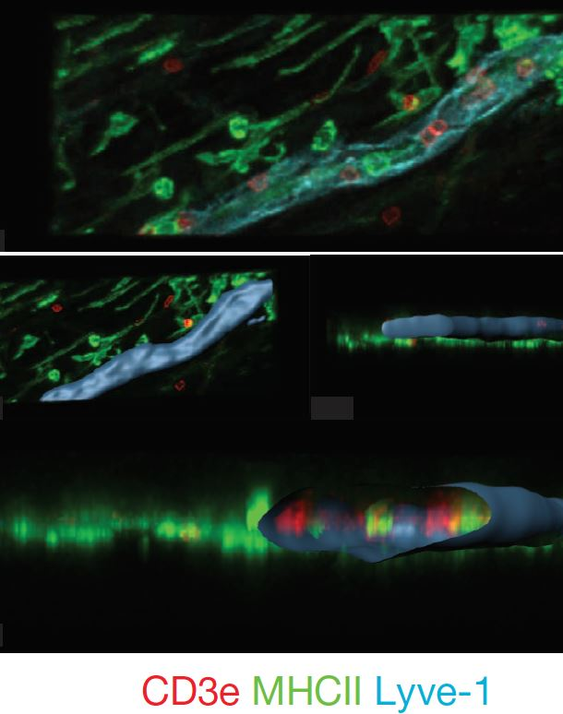
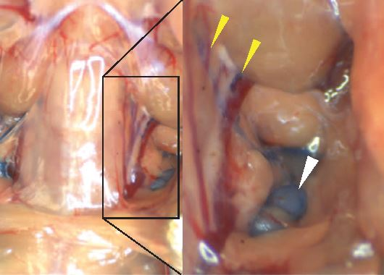
They further showed that these lymphatic vessels are able to carry both fluid and T lymphocytes and dendritic cells from the cerebrospinal fluid, and are draining into the deep cervical lymph nodes (30 min after icv injection, Evans blue appeared in meningeal lymphatic vessels, and had drained into the deep cervical lymph nodes).
Evans blue-filled vessels
Lymph node

Slide 16
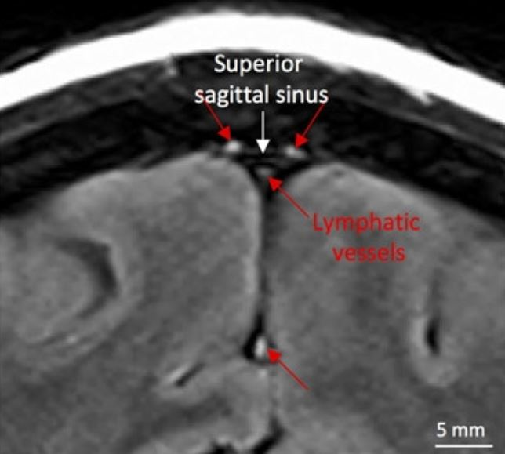
Absinta M, Ha SK, Nair G, Sati P, Luciano NJ, Palisoc M, Louveau A, Zaghloul KA, Pittaluga S, Kipnis J, Reich DS. Human and nonhuman primate meninges harbor lympatic vessels that can be visualized noninvasively by MRI. Elife. 2017 Oct 3;6
Artefact?

Slide 17
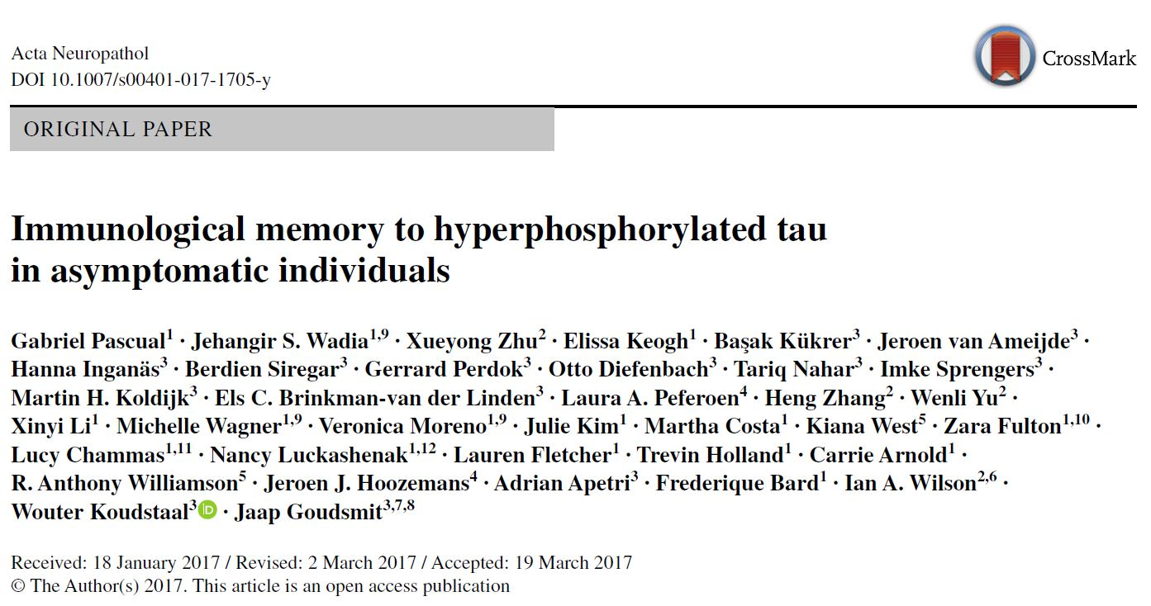
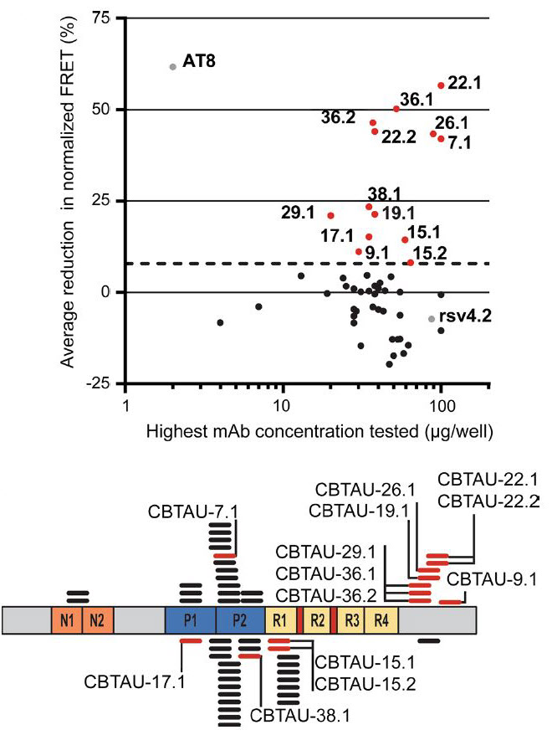
Several recent reports have described the presence of antibodies against AD-associated hyperphosphorylated forms of tau in serum of healthy individuals.
In Pascual 2017 study, 52 tau-binding antibodies were identified, corresponding to 35 unique clonal families: 41 of these antibodies recognize epitopes in the proline-rich and C-terminal domains, and binding of 26 of these antibodies is strictly phosphorylation dependent.

Slide 18
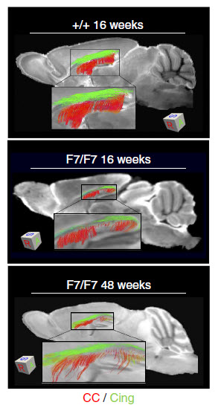
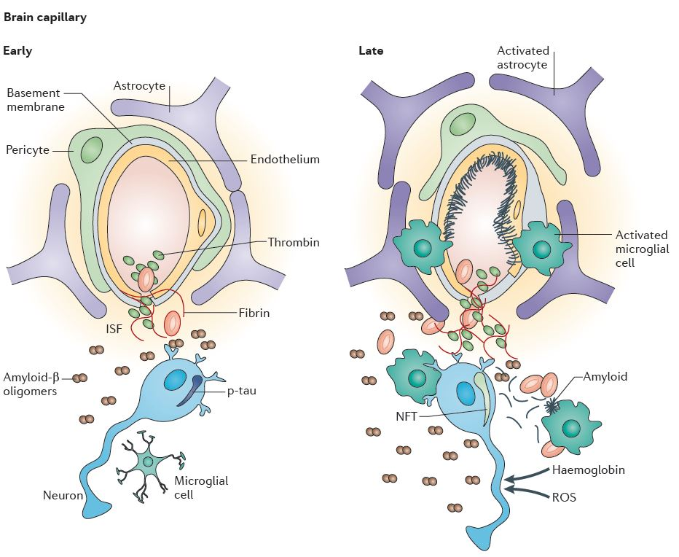
Zlokovic et al., Cell, 2008

Slide 19
Reverzibilni uzroci demencije
„Neurokirurška” stanja | Infekcije | Metabolički uzroci | Ostali uzroci
subduralni hematom ili empijem | meningitis (TBC, gljivični, itd.) | hipotireoza | depresija (pseudodemencija)
idiopatski normotenzivni hidrocefalus | encefalitis (HIV, herpes) | Hashimoto encefalitis | epilepsija
Intrakranijalne mase (tumori, apscesi) | cerebralni vaskulitis | hipertireoza | lijekovi (s antikolinergičkim učinkom)
 | neurosifilis | hipo- i hiperperatiroidizam | alkoholizam
 | Lajmska bolest (borelioza) | hiperkalcemija | autoimuni encefalitisi
 | sarkoidoza | Cushingova bolest | paraneoplastički sy
 |  | Addisonova bolest
 |  | hipoglikemija
 |  | Deficijencija vitamina B1, B6, B9, B12
 |  | kronična bolest jetre
 |  | kronična plućna bolest
 |  | kronična renalna bolest
 |  | Wilsonova bolest

Slide 20
kad nema B12 – B9 ostaje „zarobljen” („folate trap”)
najvažniji donor jednog atoma ugljika
L-
metionin sintaza
CH₃
+
Homocistein uzrokuje
oksid. stres,
cijepanje DNA, aktvaciju kaspaze-3, itd.
nakuplja se u cirkulaciji kad
postoji manjak
B6, B9 ili B12
in vitro direktno povećava fosforilaciju, cijepanje i oligomerizaciju tau proteina
L-
serin
B₆
piridoksin
glicin
riboflavin
donira jedan atom ugljika
dUMP (deoksiuridin monofosfat ---------> dTMP (deoksitimidin monofosfat)
(za DNA nukleotid timidin)

Slide 21
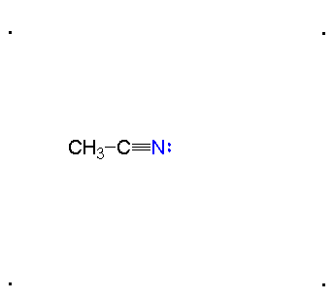
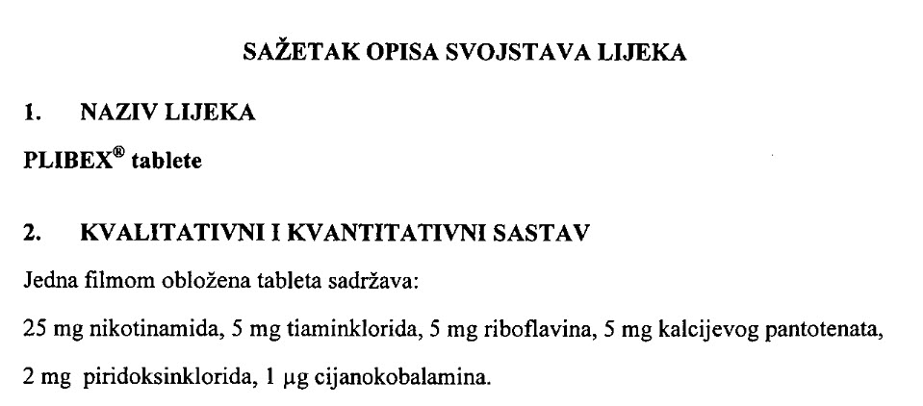
B12 – metkobalamin (iz životinjskog mesa i iznutrica, bolje se apsorbira i ima dulju bioraspoloživost) / cijanokobalamin (sintetski – u većini vitaminskih pripravaka)

Slide 22
Rano otkrivanje uzroka demencije
Smisao ranog otkrivanja uzroka demencije jest u tome da se bolest zaustavi u što ranijem stadiju tj. prije nastupa nepopravljivih oštećenja mozga i posljedičnog gubitka mentalnih sposobnosti. Najprije treba isključiti reverzibilne uzroke demencije!
Najvažnija strategija za ostvarenje tog cilja je iznalaženje bioloških biljega (biomarkera) kojima bi se što ranije i pouzdanije otkrilo patološki proces, po mogućnosti i prije nastupa kliničkih simptoma i znakova bolesti (pretklinički/prodromalni stadij).
Da bi se neki biomarker odobrio za uporabu u kliničkoj praksi najprije mora proći postupak validacije kroz veći broj multicentričnih istraživanja na velikom broju ispitanika.

Slide 23
Uskoro će FDA gledati učinak liječenja Alzheimerove bolesti prema nalazu biomarkera, a ne prema kliničkom statusu:
http://www.sciencemag.org/news/2018/02/fda-floats-new-rules-testing-alzheimers-drugs?utm_campaign=news_weekly_2018-02-16&et_rid=40182222&et_cid=1855583

Slide 24
Rano otkrivanje uzroka demencije
Smisao ranog otkrivanja uzroka demencije jest u tome da se bolest zaustavi u što ranijem stadiju tj. prije nastupa nepopravljivih oštećenja mozga i posljedičnog gubitka mentalnih sposobnosti. Najprije treba isključiti reverzibilne uzroke demencije!
Najvažnija strategija za ostvarenje tog cilja je iznalaženje bioloških biljega (biomarkera) kojima bi se što ranije i pouzdanije otkrilo patološki proces, po mogućnosti i prije nastupa kliničkih simptoma i znakova bolesti (pretklinički/prodromalni stadij).
Da bi se neki biomarker odobrio za uporabu u kliničkoj praksi najprije mora proći postupak validacije (osjetljivost, specifičnost, korelacija s napredovanjem bolesti) kroz veći broj multicentričnih istraživanja na velikom broju ispitanika.

Slide 25
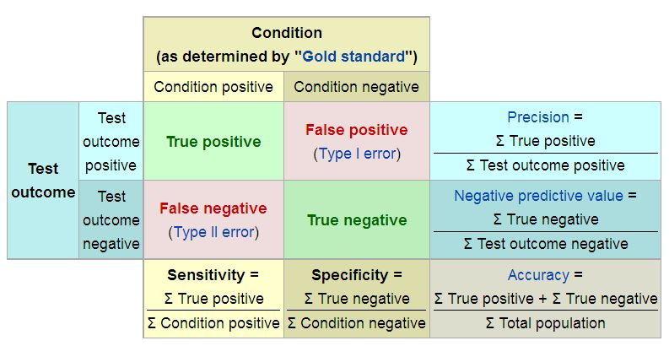
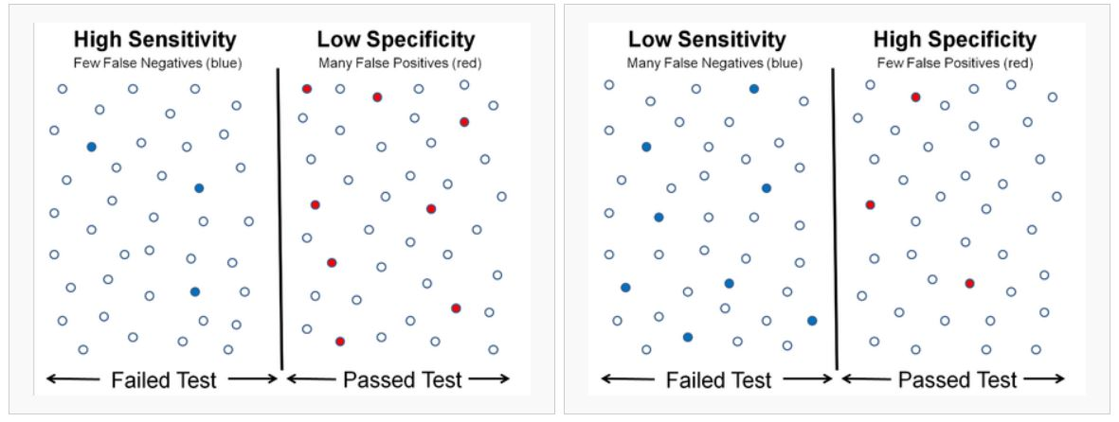
Glavna obilježja svih bioloških biljega
1 (Patološka) specifičnost
2 (Rana dijagnostička) osjetljivost
3 Korelacija s progresijom bolesti
= da su negativni stvarno negativni
Sensitivity = hit rate=TPR=TP/P=TP(TP+FN)
FPR=1-TPR=FP/N
= da su pozitivni stvarno pozitivni
Specifičnost i osjetljivost nekog biljega ne mogu se promatrati odvojeno. Prema preporukama međunarodnih konzorcija „idealan” biološki biljeg bi trebao imati i specifičnost i osjetljivost veću od 85%.

Slide 26
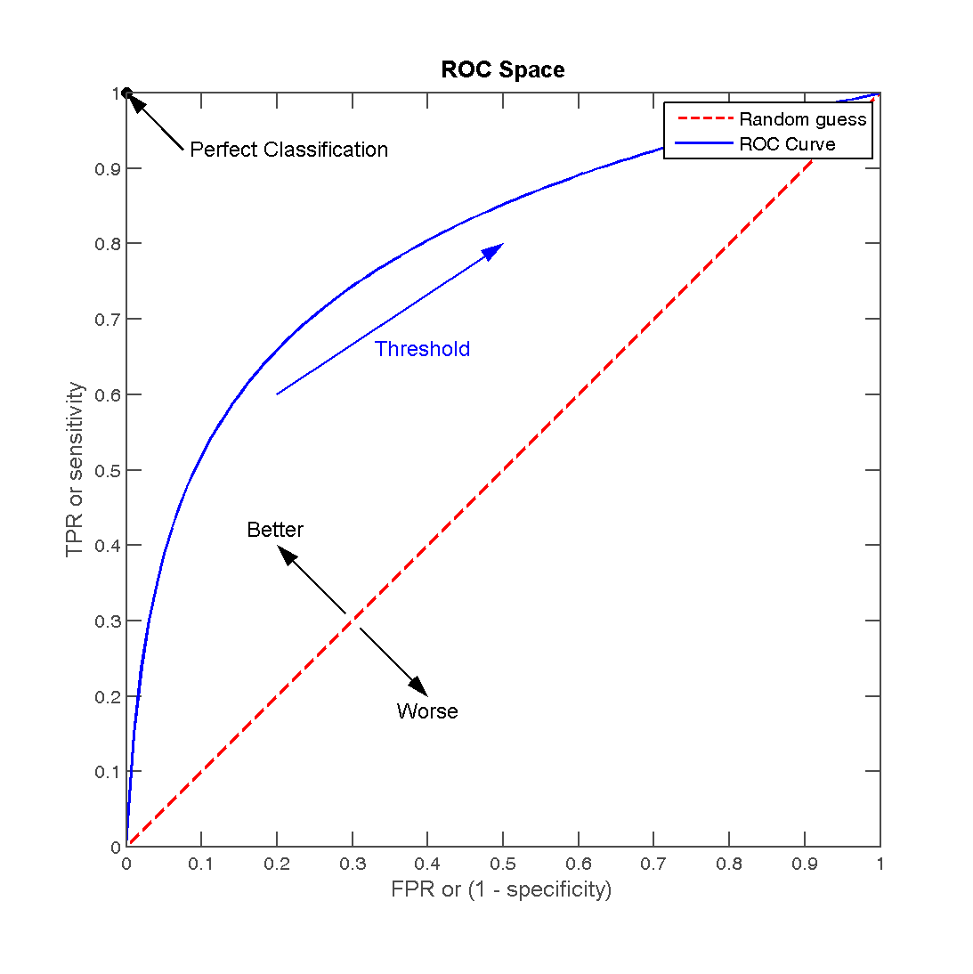
Grafički prikaz klasifikacijske f-je biljega (međuodnosa specifičnosti i osjetljivosti)
Točno klasificirani ispitanici
Svi negativni + lažno pozitivni ispitanici

Slide 27
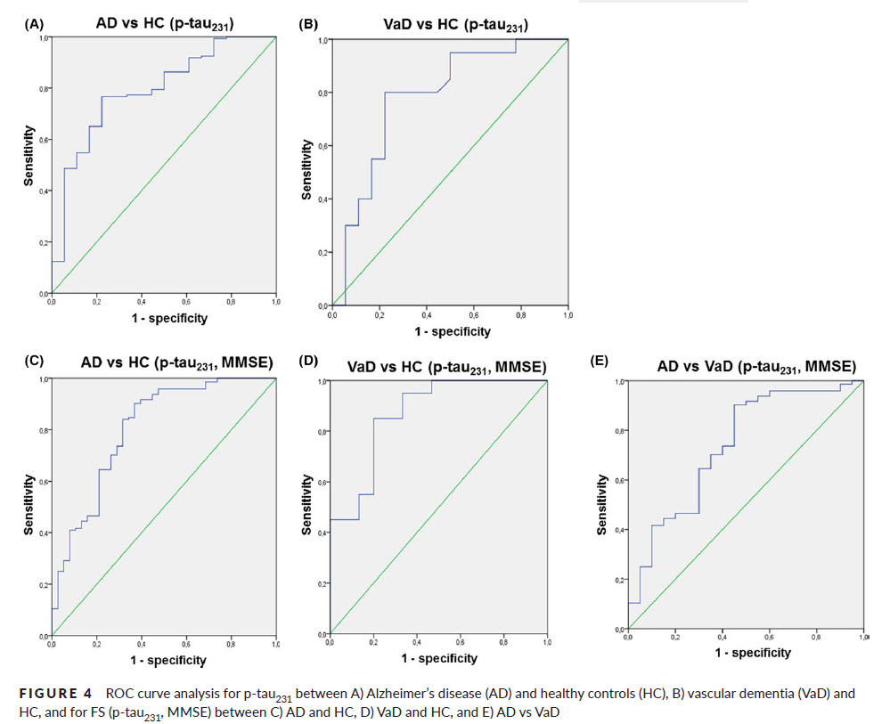

Slide 28
6 main biomarker approaches to the diagnosis and monitoring potential treatments of AD
behavioral assessment, including measurement of cognitive status using various neuropsychological scales (MMSE, ADAS-Cog, etc.)
changes in brain structure (mainly volume of the cerebral cortex, particularly entorhinal cortex and hippocampus)
alterations in brain’s functional (fMRI) and structural (DTI) connectivity, and metabolism (FDG-PET) most notably within the default mode network
measurement of β-amyloid load within the brain (PIB-PET), and of neurofibrillary tangles (FDDNP-PET)
CSF biomarker profiles (the three main CSF biomarkers of AD being β-amyloid, total tau, and phosphorylated forms of tau proteins)
(post-mortem confirmation of characteristic AD histopathology).

Slide 29
Conclusions on 6 main approaches for diagnosing and monitoring potential treatments of AD
123 behavioral assessment, including measurement of cognitive status using various neuropsychological scales (MMSE, ADAS-Cog, etc.)
123 changes in brain structure (mainly volume of the cerebral cortex, particularly entorhinal cortex and hippocampus)
123 alterations in brain’s functional (fMRI) and structural (DTI) connectivity, and metabolism (FDG-PET) most notably within the default mode network
123 measurement of β-amyloid load within the brain (PIB-PET)
(FDDNP-PET - not enough data for firm conclusions)
123 CSF biomarker profiles (the three main CSF biomarkers of AD being β-amyloid, total tau, and phosphorylated forms of tau proteins)
123 post-mortem confirmation of characteristic AD histopathology.

Slide 30
Conclusions on 6 main approaches for diagnosing and monitoring potential treatments of AD
123 behavioral assessment, including measurement of cognitive status using various neuropsychological scales (MMSE, ADAS-Cog, etc.)
123 changes in brain structure (mainly volume of the cerebral cortex, particularly entorhinal cortex and hippocampus)
123 alterations in brain’s functional (fMRI) and structural (DTI) connectivity, and metabolism (FDG-PET) most notably within the default mode network
123 measurement of β-amyloid load within the brain (PIB-PET)
(FDDNP-PET - not enough data for firm conclusions)
123 CSF biomarker profiles (the three main CSF biomarkers of AD being β-amyloid, total tau, and phosphorylated forms of tau proteins)
123 post-mortem confirmation of characteristic AD histopathology.
Zaključak: Biomarkere treba kombinirati!

Slide 31
Likvorski biomarkeri u dijagnostici NDD
Bolest | Ukupni tau | P-tau | Aβ₁₋₄₂
AD | ↑↑ | ↑↑↑ | ↓↓
CJD | ↑↑↑ | 0 | ↓↓
FTLD | ↑ | 0 | ↑↑
DLB | ↑ | ↑ | ↓↓
VaD | ↑ | ↑ | ↓
Normalno starenje, PD, MDD (major depressive disorder), WKD (Wernicke-Korsakoff disease) | 0 | 0 | 0

Slide 32
Konačno biološki biljeg Alzheimerove bolesti u plazmi?
POSEBNOST: the Japanese National Center for Geriatrics and Gerontology (NCGG) (121 samples), and was externally validated using an independent data set derived from the Australian Imaging, Biomarker and Lifestyle Study of Ageing (AIBL) cohort (252 samples)

Slide 33
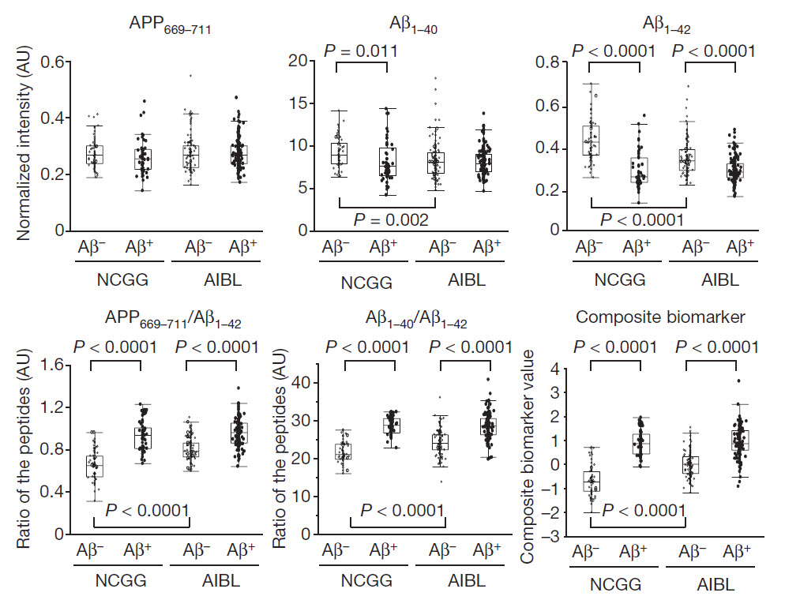

Slide 34
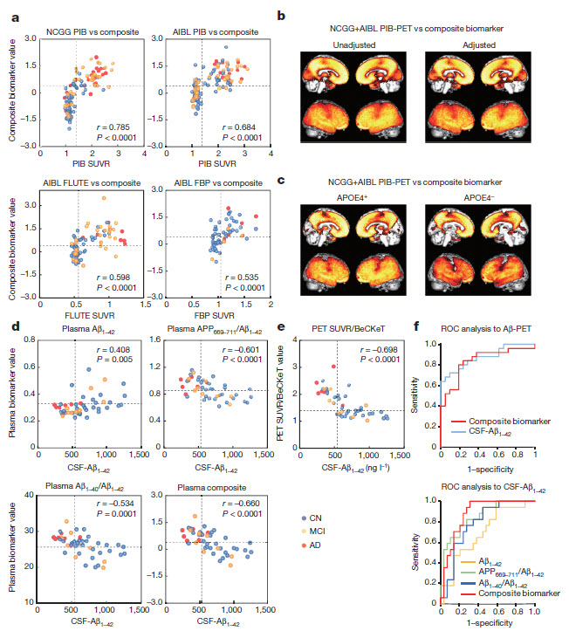
Plasma biomarkers significantly correlated with brain Aβ burden and CSF-Aβ_{1–42} levels

Slide 35
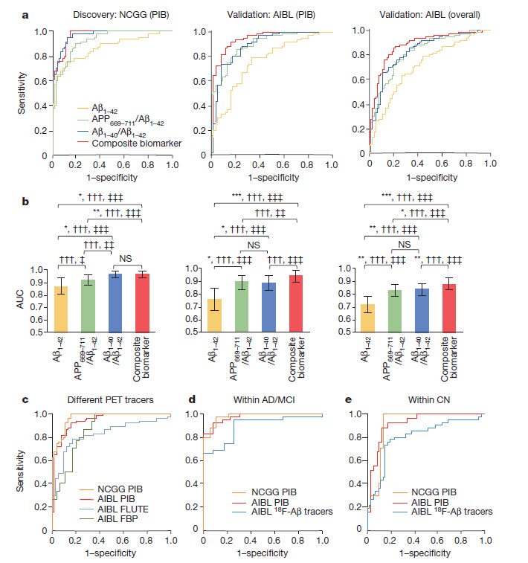

Slide 36
Hvala na pažnji!
Hrvatska zaklada za znanost
Projekt IP-2014-09-9730 (2015-2019)
Hiperfosforilacija, agregacija i transsinaptički prijenos
tau proteina u Alzheimerovoj bolesti: analiza cerebrospinalne tekućine i ispitivanje potencijalnih neuroprotektivnih spojeva
The European Union through the
European Regional Development Fund, Operational Programme Competitiveness and Cohesion, grant agreement no. KK.01.1.1.01.0007, CoRE – Neuro
Croatian Science Foundation

