Slide 1
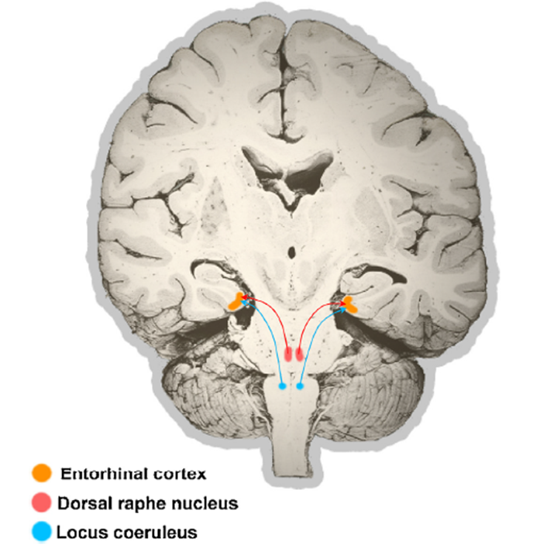
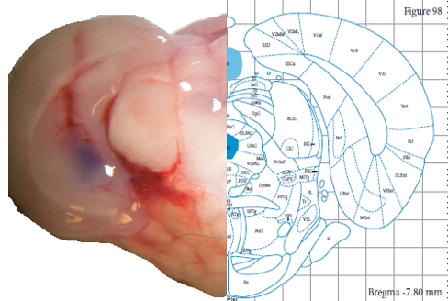
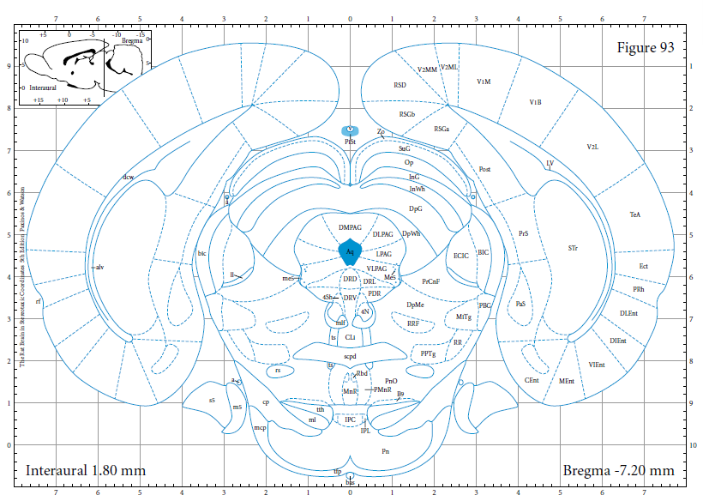
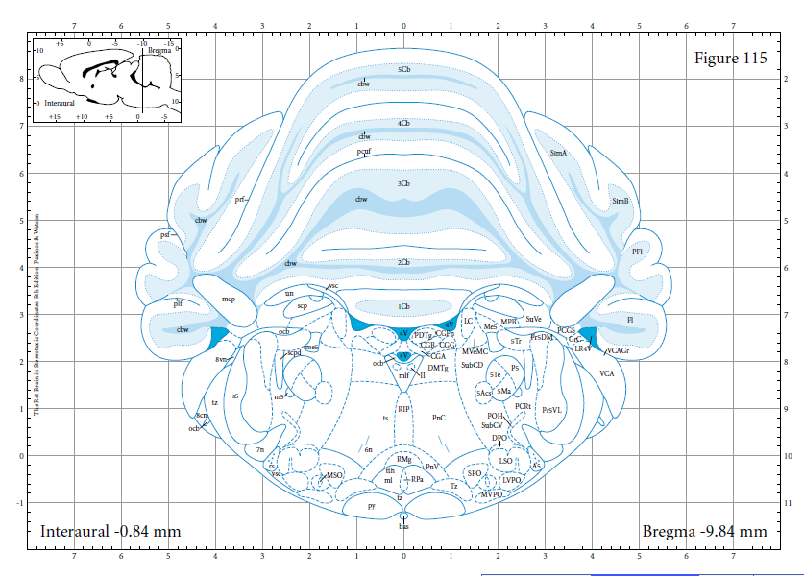
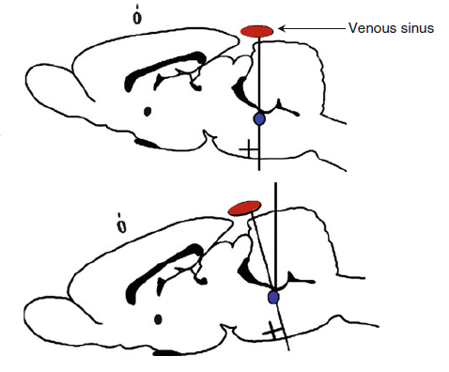
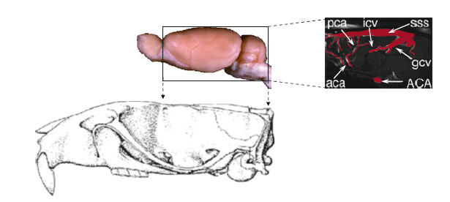
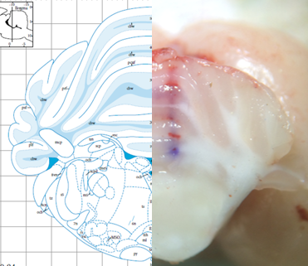
Protocol for stereotaxic delivery of tau monomers and oligomers into the rodent brain
Lea Langer Horvat*¹, Jan Svoboda², Mirjana Babić Leko¹, Terezija Miškić¹, Marina Kukolj³, Nada Oršolić³, Patrick R. Hof⁴, Goran Šimić¹
¹Croatian Institute for Brain Research, School of Medicine, University of Zagreb, Šalata 12, 10000 Zagreb, Croatia
²Institute of Physiology AS CR, v.v.i., Department of Neurophysiology of Memory, Vídeňská 1083, 14220 Prague 4, Czech Republic
³Faculty of Science, Division of Animal Physiology, University of Zagreb, Rooseveltov trg 6, 10000 Zagreb, Croatia
⁴Fishberg Department of Neuroscience and Friedman Brain Institute, Icahn School of Medicine at Mount Sinai, New York, NY, USA
Introduction
Objective
In the most prevalent tauopathy, Alzheimer's disease, tau pathology progressively spreads in an anatomically stereotypical manner throughout the brain.
It has been shown that the locus coeruleus is among the first structures affected by tau protein abnormalities and as it has a substantial projection to the transentorhinal and entorhinal cortex, these regions may be contributing to early neurofibrillary changes in AD.
To test the pathogenic spread hypothesis in wild type rats by injecting a single dose of soluble oligomeric forms of human tau protein (hTau) in the entorhinal cortex and locus coeruleus and to assess whether such a neuron-to-neuron physical spread of protein aggregates is required for pathogenesis.
In this protocol, we describe stereotaxic surgery optimized for delivery of tau monomers and oligomers into the locus coeruleus and entorhinal cortex.
Adopted from Šimić et.al, 2017
Methodology and rationale
Results
Validation of coordinates for the entorhinal cortex (EC)
Validation of coordinates for locus coeruleus (LC)
Figure 1. Verification of coordinates for the entorhinal cortex (EC) in the rat using cresyl violet
Stereotaxic coordinates for the entorhinal cortex determined from the 2004 stereotaxic rat brain atlas of Paxinos and Watson
Stereotaxic coordinates for locus coeruleus determined from the 2004 stereotaxic rat brain atlas of Paxinos and Watson
trace of cresyl-violet
structure size
1.0 x 0.8 mm
structure size
0.8 x 0.3 mm
Validated coordinates AP -7.20 mm
ML 3.8 mm
DV 8.3 mm
Adopted from Paxinos and Watson, 2004
Adopted from Paxinos and Watson, 2004
For targeting the ventral entorhinal cortex, which is not visible form the surface of the opened skull, it is necessary to use a 14° inclination of the microinjection unit in mediolateral direction
To target the locus coeruleus, which is close to the midline, it is necessary to calculate an appropriate angle to avoid the transverse venous sinus. The obstacle that this blood vessel presents can be bypassed by a forward inclination of the head at an angle of about15°
Figure 2. Verification of coordinates for the locus coeruleus in the rat using cresyl violet
temporal crest
Adopted from Paxinos and Watson, 2004
pca -pericallosal artery
aca -anterior cerebral artery
icv -internal cerebral vein
gcv -great cerebral vein
sss - superior sagittal sinus
Stabilize the rat in the stereotaxic apparatus
Adopted from B. Ferry et al., 2014
trace of cresyl- violet
Anesthetic gas
14°
forward inclination of the head
Ear bars
Validated coordinates AP –3.4 mm
ML 1.1 mm
DV 5.1 mm
Visualization of bregma and lambda landmarks
relative to Paxinos lambda
Conclusions and future work
Gas anesthesia mask
Key technical requirements had to be fulfilled before and during the procedure so that the target structure is attained with maximal precision. The stereotaxic coordinates need to be validated relative to age, sex, strain, and the topography of the vascular system of the rat. In conclusion, we hope that our approach will improve the understanding of the development of tau pathology in rodent experimental models of neurodegenerative diseases.
Acknowledgments
This work is financially supported by the Croatian Science Foundation (grant no. IP-2014-09-9730).
Notes:
Animals: the experiment was performed on nontransgenic rat model
It has been shown that the locus coeruleus is among the first structures affected by tau protein abnormalities during the course of Alzheimers’s disease
Progressive accumulation of misfolded tau protein in the central nervous system is one of the most predominant characteristic of taupathies.
the tau pathology manifests in early stages of the disease in locus coeruleus and enthorinal cortex, and progressivel spreads to other brain areas in a stereotypical fashion through anatomicall connected regions.

