Slide 1
Fresh Ideas on Architecture of Cognitive Processing and Alzheimer's Disease Pathogenesis: Possibilities for Translation into Clinical Practice
Goran Šimić MD, PhD
Croatian Institute for Brain Research
Medical School University of Zagreb, Croatia
Partnering for Impact in Global and Public Health Symposium:
Facilitating Global Health Research Collaborations in Neuroscience
The MUSC Department of Public Health Sciences and
The MUSC Center for Global Health Medical University of South Carolina
Nov 3-4, 2015, Charleston, South Carolina, U.S.A.
Grant no. 09/16 (2012-2014)
Grant no. IP-2014-09-9730 (2015-2019)
Croatian Science Foundation

Slide 2
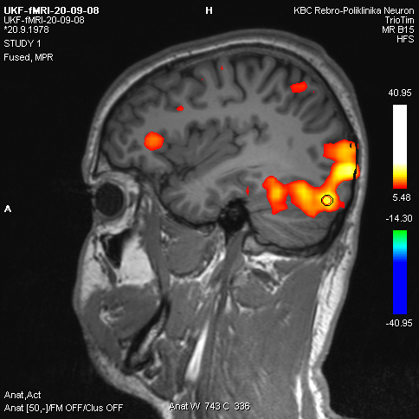
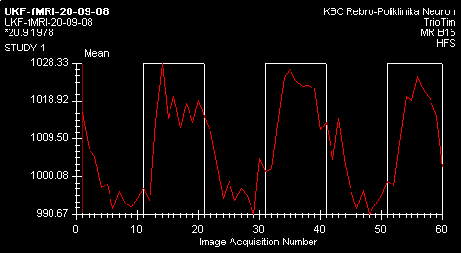
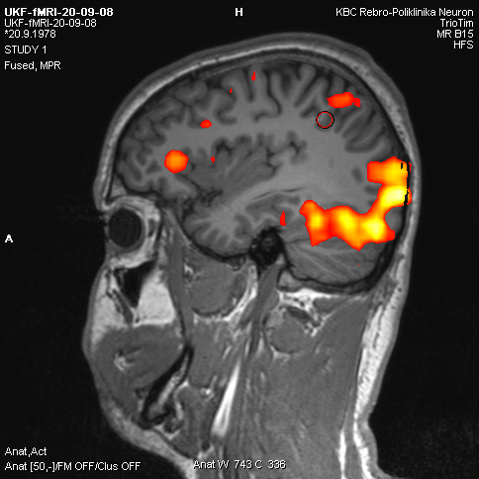
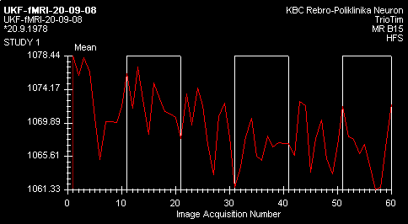
Correlation between stimulus and signal in task-related fMRI
The difference between baseline and task-related activation accounts for about 1–5% of the total BOLD signal (thus, compared to ongoing ‘baseline’ brain activity, only a small percentage is needed to respond to an external stimulus)
Stimulus e.g. image
Stimulus e.g. image
Stimulus e.g. image
+
+
+
Correlation
YES
Stimulus e.g. image
Stimulus e.g. image
Stimulus e.g. image
+
+
Correlation
NO

Slide 3
Signal intensity change in task-related fMRI
1020
2,5%
995
Relatively small changes in signal intensity (1 – 5%):
you do not have to „reboot” your brain every time you need to respond to
some environmental stimuli (e.g. threats)

Slide 4
Resting-state fMRI focuses on spontaneous, rather than task-induced, fluctuations in BOLD signal
ICA separates linearly
mixed sources:
Task related
Heart-beat related
Breathing related
Vasomotor oscillation
Motion related
„white noise”

Slide 5
How ICA principle works (an example)
A
2 independent sources
B
Linear mix: A-2B
Linear mix: 1.73*A+3.41*B
ICA algorithm

Slide 6
ICA applied to resting-state fMRI data identifies 8 cortical networks..
Primary
vision
Higher order
visual
processing
Hearing
Touch and
movement
DMN
(memory)
Salience
processing
Executive
control
Executive
control
Beckman et al., 2005, Philos. Trans. R Soc. Lond. B, 2005, 360, 1001–1013
Greicius M, Curr. Opin. Neurol., 2008, 21, 424-430

Slide 7
.. with the DMN being the main one (resting brains never rest!) and consisting of
mPFC,
PCC,
precuneus,
ACC,
parietal cortex and in a minority of studies also the hippocampus
Hafkemeijer et al., Biochim. Biophys. Acta, 2012, 1822, 431-441
DMN undergoes developmental changes and coherent neuronal oscillations at a rate lower than 0.1 Hz become more consistent in children aged 9-12 years and in older subjects
It seems that DMN connectivity reflects the level of consciousness (Greicius et al., Hum. Brain Mapp., 2008; Vanhaudenhuyse et al., Brain, 2010), generates spontaneous thoughts, and preferentially activates when individuals engage in internal tasks such as daydreaming, envisioning the future, and retrieving memories, while it is negatively correlated with brain systems that focus on external visual signals (when DAN activates)

Slide 8
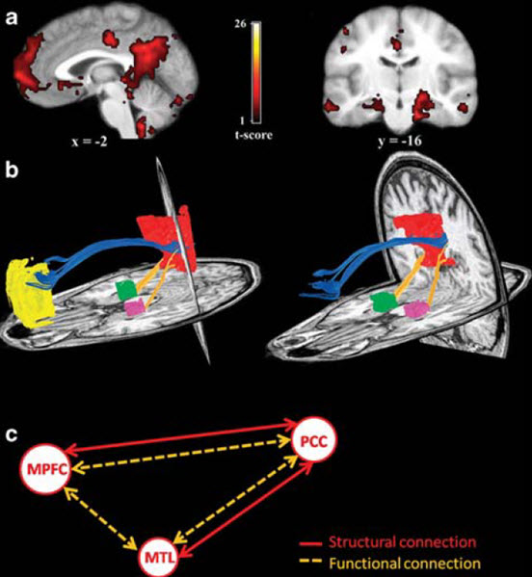
DMN fc vs DTI
Most of baseline activity is mediated by neurons that are constantly active and participate in the default mode network (DMN, also known as „the resting state” or „task-negative” network) (Deco et al., TINS, 2013).
fMRI
DTI
Damoiseaux et al., Brain Struct. Funct. 2009, 213, 525-533

Slide 9
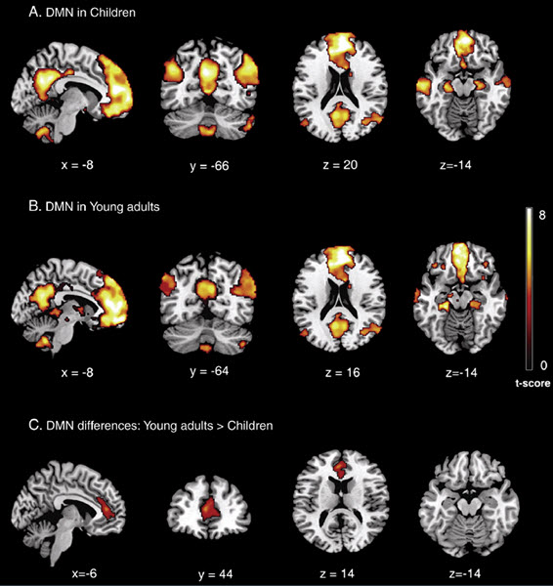
DMN activity in mPFC is weaker in children
Supekar et al., NeuroImage, 2010, 52, 290-301

Slide 10
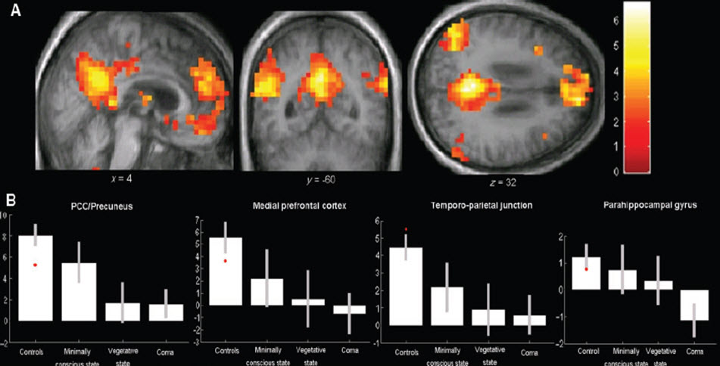
DMNfc correlates with the level of consciousness
Vanhaudenhuyse et al., Brain, 2010, 133, 161-171

Slide 11
DMN in healthy elderly and AD subjects
(WashU data)
Healthy elderly subjects
Alzheimer’s disease subjects
Greicius et al., PNAS, 2004, 101, 4637-4642
AD subjects showed highly significant decreased resting-state activity in PCC (blue arrow), hippocampus and entorhinal cortex (green arrow).

Slide 12
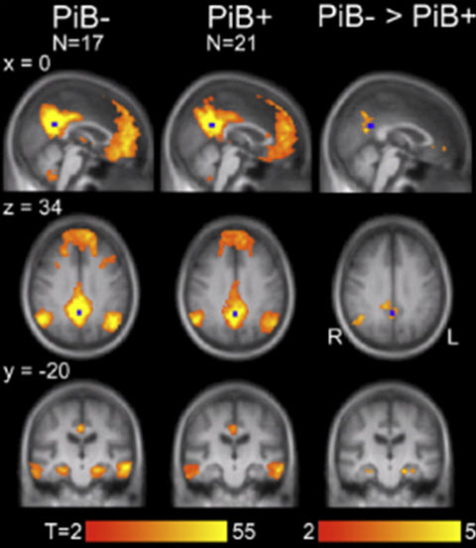
Correlation of β-amyloid deposition (PIB PET) and DMN fc
Clinically normal participants with high amyloid
burden displayed significantly reduced f-nal correlations within DMN, including f-nal disconnection of the hippocampal formation relative to participants with low amyloid burden. These reductions were also observed when controlling for age and structural atrophy
Seed in PCC
(blue box)
Hedden et al., J. Neurosci., 2009, 29, 12686-12694;
findings confirmed in Sheline et al., Biol. Psychiatry, 2010, 67, 584-587

Slide 13
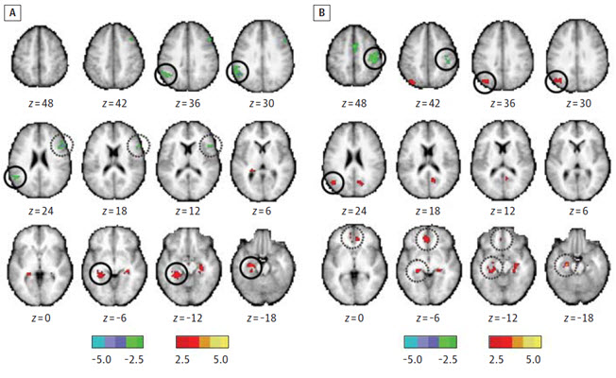
Biomarker correlation
CSF Aβ<500 pg/mL
vs. CSF Aβ >500 pg/mL
CSF p-tau181>80 pg/mL
vs. CSF p-tau181<80 pg/mL
The main opposing network to DMN is the Dorsal Attention Network (DAN): DAN turns off when DMN activates and vice-versa
In participants with low CSF Aβ42 and high p-tau181 (207 cognitively normal participants with preclinical AD), this switching between networks becomes sloppy: in these people, some nodes of the DAN did not turn off when DMN was active
increase decrease in f-nal conn.
increase decrease
PCC & MTL
MTL & mPFC
Wang et al., JAMA Neurol., 2013, Aug 29, Epub ahead of print

Slide 14
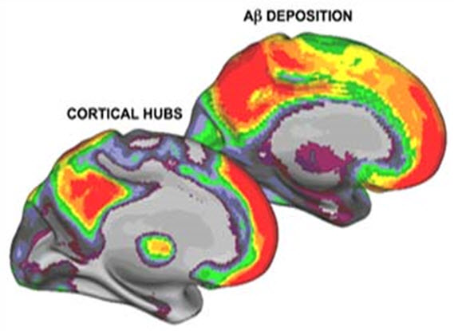
DMN cortical hubs and β-amyloid deposition overlap
Buckner et al., J. Neurosci., 2009, 29, 1860-1873

Slide 16
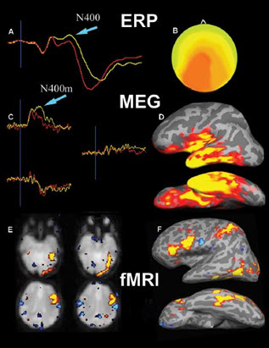
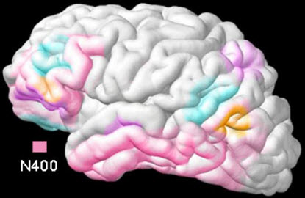
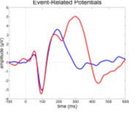
Spatiotemporal dynamics of word processing in the human cortex (MEG + fMRI + ERP); P300 and N400 as early non-invasive biomarkers of AD
P300
P300 is a normal response
to novel stimuli
P100 stimulus detection
P200 high-order perceptual
processing, modulated
by attention
P300 cognitive or affective
processing of the stimulus
N400 is a normal response to meaningful stimuli (e.g. meaningful sentences)
Marinkovic et al., and others

Slide 17
Five novel concepts regarding cognition and AD
1. human brain has got an „operative system” (in analogy with computers): the core of this operative system is the default mode network (DMN)
2. default-mode network (DMN) activity is weaker in children and reflects the level of consciousnes
3. DMN cortical hubs and amyloid-β (Aβ) deposition overlap: during SWS neurons spend about 50% less energy and produce much less Aβ (the net result being a clearance of Aβ); as more Aβ is accumulated – the sleep becomes shorter (a vicious cycle)
4. AD subjects show highly significant decreased resting-state activity in posterior cingulate cortex (PCC), hippocampus and entorhinal cortex as well as sloppy switching between DMN and DAN (dorsal attention network, even in preclinical cases who have positive values of core AD biomarkers)
5. P300 and N400 event-related potentials (ERPs) can serve as non-invasive biomarkers of early AD

