Slide 1
Using deep-learning artificial intelligence to resolve the mechanistic relationship between Alzheimer's disease and gut microbiota Goran Šimić MD, PhD Department of Neuroscience Croatian Institute for Brain Research University of Zagreb Medical School REPUBLIC OF CROATIA
Sunday, Sept 17, 2017
Plenary lecture no. 3
12.00 – 12.30 h
Croatian Science Foundation
IP-2014-09-9730 (2015-2019)

Slide 2
Abstract from the Book of Abstracts, p. 31
Recently emerging “deep learning” systems and artificial neural networks need not be programmed exclusively with a human expert’s knowledge. Instead, they can learn on their own, often from big datasets that are far larger than humans can cope with, until they can see patterns. In two recently published studies (Gubiani et al., Expert Syst. Appl., 2017; Cestnik et al., Genomics Comp. Biol., 2017) authors used the literature mining tools of OntoGen to document clustering and CrossBee for cross-domain bridging term exploration to search for hidden relations in scientific papers from two domains of interest, Alzheimer’s disease and gut microbiome. The results supported the hypothesis of the neuroinflammatory nature of Alzheimer’s disease and identified several potential links: nitric oxide synthase, Lactobacillus, bile acid (ABC transporters), and serotonin. However, as advanced artificial intelligence systems cannot explain their logic and the computations that lead to an outcome remain hidden, I will make an attempt to open up the black box of machine thinking behind these discoveries, and provide insights about the mechanisms that led to the outcomes to help interpreting the associations observed.

Slide 3
AI for research
Generating new scientific hypotheses has always required a lot of expert knowledge and creativity. Nowadays, it also requires the ability to search, analyze and relate enormous quantities of potentially relevant pieces of information, dispersed in scientific literature and all too often confined to isolated knowledge silos of individual scientific disciplines. Therefore, computational support to scientific discovery, one of the earliest and most successful areas of AI research, has again raised attention of numerous researchers.

Slide 4
Gut microbiota and neurodegeneration
Recent literature on gut microbiota supports the strong relationship between the human digestive system and neurodegenerative diseases (such as Parkinson’s and Alzheimer’s disease) indicating new trajectories for original biomedical research (Ghaisas et al., Pharmacol. Ther., 2016).

Slide 5
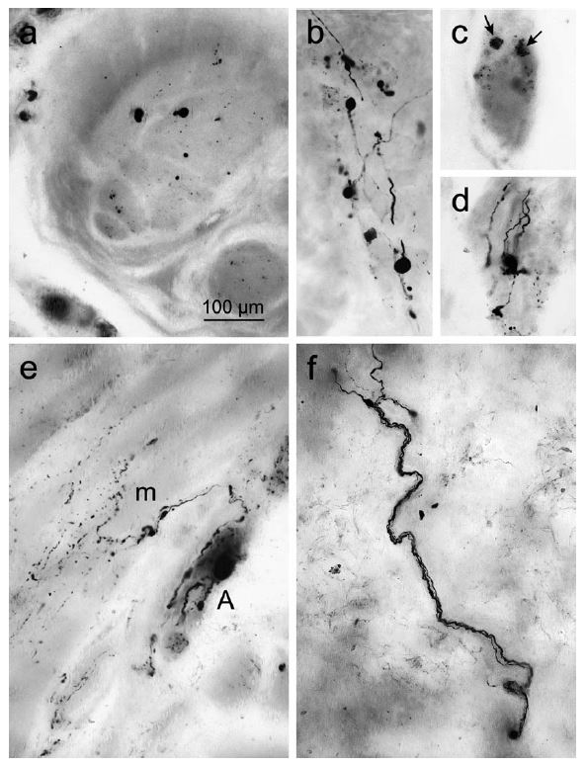
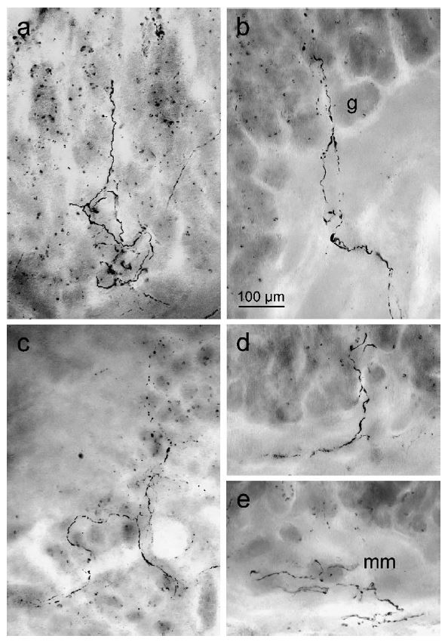
Syn-1 ir in Meissner’s and Auerbach’s plexuses in PD
S.J. Qualman, H.M. Haupt, P. Yang, S.R. Hamilton, Esophageal Lewy bodies associated with ganglion cell loss in achalasia, similarity to Parkinson’s disease., Gastroenterology 87 (1984) 848–856.
Braak H, de Vos RA, Bohl J, Del Tredici K (2006) Gastric α-synuclein immunoreactive inclusions in Meissner’s and Auerbach’s plexuses in cases staged for Parkinson’s disease-related brain pathology. Neurosci Lett 396:67–72.
Braak H, Del Tredici K (2009) Neuroanatomy and pathology of sporadic Parkinson’s disease. Adv Anat Embryol Cell Biol 201:1–119.

Slide 6
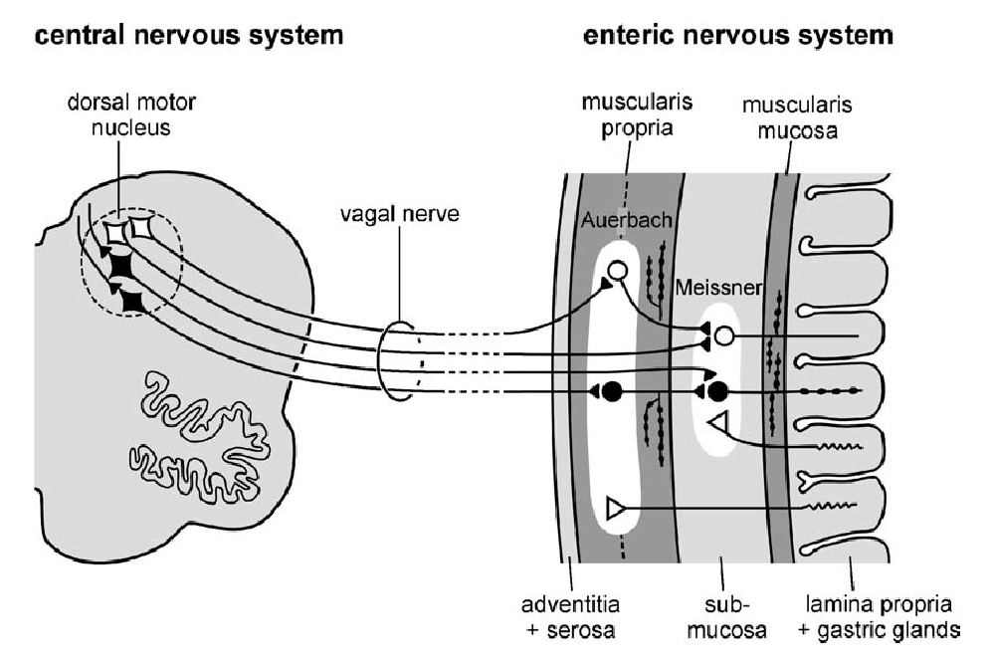
Gut and Parkinson’s disease
Hypothesis: a putative environmental pathogen capable of passing the gastric epithelial lining might induce α-synuclein misfolding and aggregation in specific cell types of the submucosal plexus and reach the brain via a consecutive series of projection neurons where α-synuclein is transported retrogradely (and anterogradely from cx to spinal cord, unpublished)
S.J. Qualman, H.M. Haupt, P. Yang, S.R. Hamilton, Esophageal Lewy bodies associated with ganglion cell loss in achalasia, similarity to Parkinson’s disease., Gastroenterology 87 (1984) 848–856.
Braak H, de Vos RA, Bohl J, Del Tredici K (2006) Gastric α-synuclein immunoreactive inclusions in Meissner’s and Auerbach’s plexuses in cases staged for Parkinson’s disease-related brain pathology. Neurosci Lett 396:67–72.
Braak H, Del Tredici K (2009) Neuroanatomy and pathology of sporadic Parkinson’s disease. Adv Anat Embryol Cell Biol 201:1–119.

Slide 7
Gut microbiome and AD?
A growing number of scientific articles in this field indicate that a link between dietary and gastrointestinal system and Alzheimer’s disease is worth investigating.

Slide 8
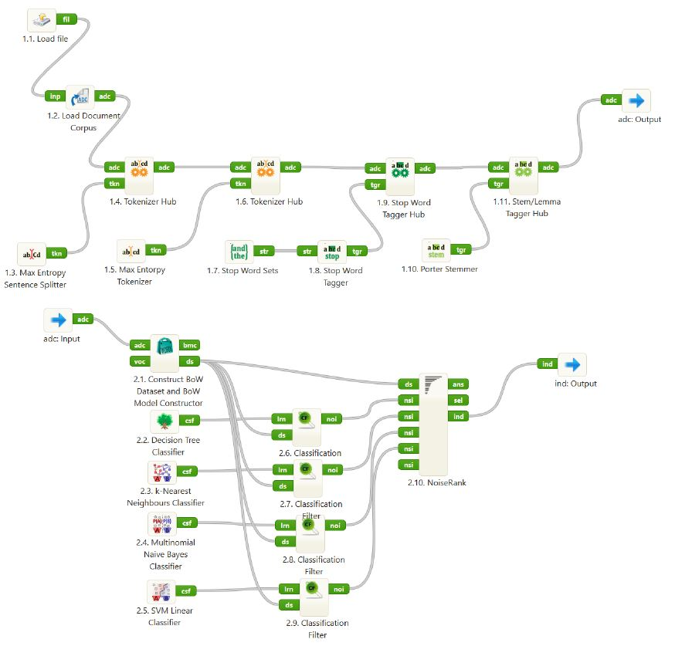
OntoGen text mining web-based platform TextFlows for advanced whole (!) text mining
Document acquisition and preprocessing (transformation of text into structured data)
Outlier document identification
Outlier document extraction

Slide 9
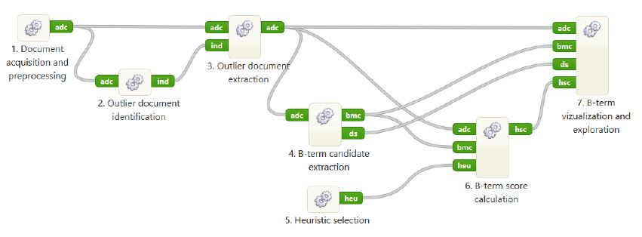
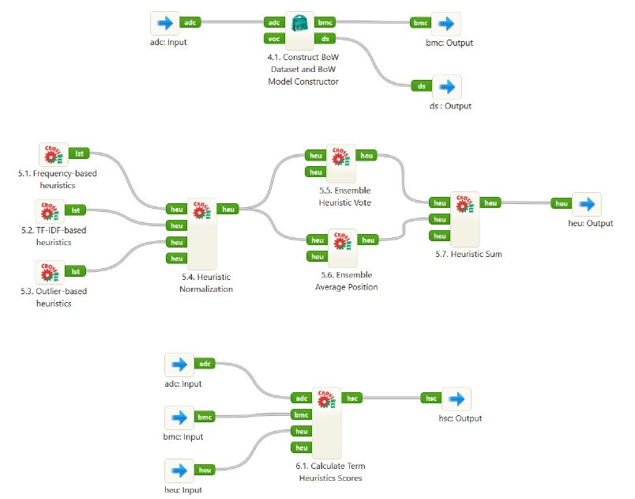
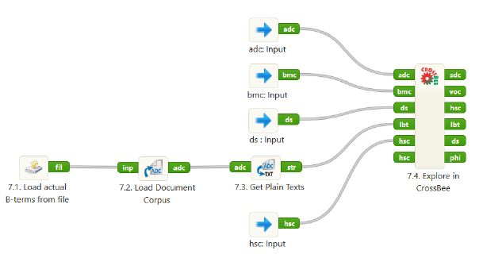
OntoGen text mining web-based platform TextFlows for advanced whole (!) text mining
4. B-term candidate extraction
5. Heuristic selection
6. B-term score calcualtion
7. B-term vizualization and exploration

Slide 10
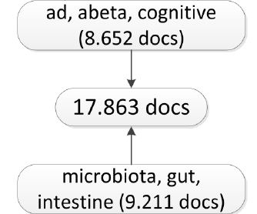
Results
„Hits”:
Serotonin
Bile acid
Lactobacillus
Nitric oxide synthase

Slide 11
Results
„Hits”:
Serotonin
Bile acid
Lactobacillus
Nitric oxide synthase
Is there any other (earlier)
common
denominator (aside of AD)?

Slide 12
Results
„Hits”:
Serotonin
Bile acid
Lactobacillus
Nitric oxide synthase
Is there any other
common
denominator (aside of AD)?
WARNING: FROM NOW ON, SOME OR MANY PARTS OF MY TALK WILL BE MY SPECULATIONS – DO NOT TAKE THEM FOR GRANTED (ALWAYS BE CRITICAL)!!

Slide 13
Results
„Hits”:
Serotonin
Bile acid
Lactobacillus
Nitric oxide synthase
No of PubMed
Publications:
832
180
COAGULATION
39
258

Slide 14
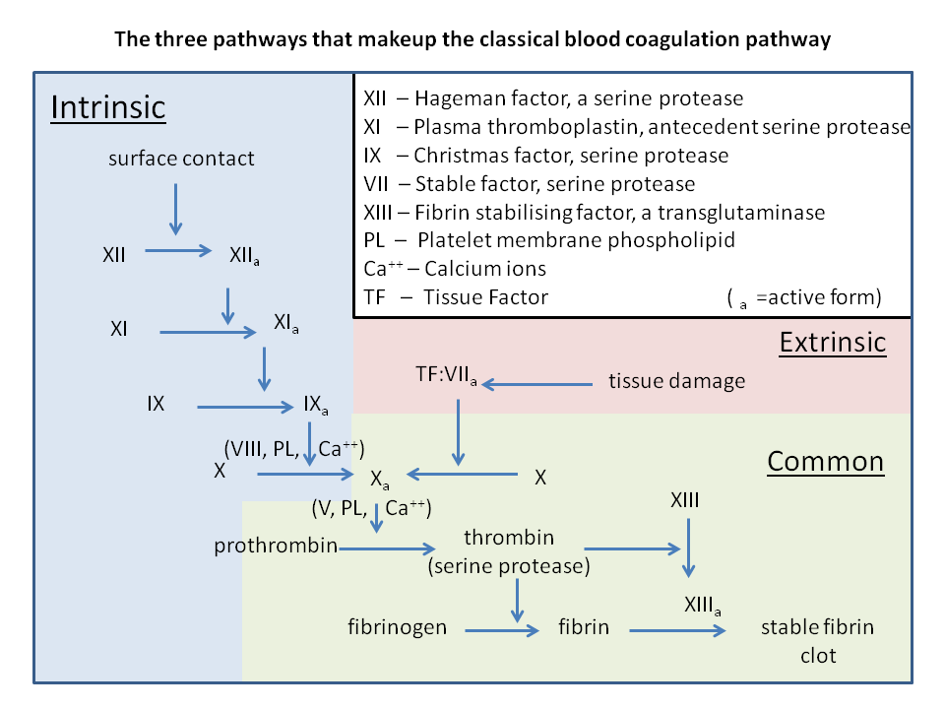
Coagulation system: highly complex, highly conserved, deficiencies are rare

Slide 15
Results
„Hits”:
Serotonin
Bile acid
Lactobacillus
Nitric oxide synthase
No of PubMed
Publications:
832
180
COAGULATION
39
258
~90% of the human body's total 5-HT is produced in the enterochromaffin cells in the gut (tryptophan hydroxylase is the rate-limiting enzyme and comes in 2 forms: TPH1 and TPH2, which is neuron-specific). Indigenous bacteria from the gut microbiota regulate host serotonin synthesis and levels of 5-HT in the blood, while altering the gut microbiota can improve 5-HT-related symptoms , such as depression (Yano et al., Cell, 2015). In the blood, 5-HT is actively taken by platelets, which store it. When bind to a clot, platelets release 5-HT. When the platelets bind to a clot, they release 5-HT (as well as protease nexin-2 (PN-2) = analog of AβPP, both released in granules from platelets, Van Nostrand, Science, 1990), where 5-HT, besides acting as a vasoconstrictor, inhibits blood clotting by inhibiting coagulation factor IXa (to activate factor X) 71x more potently than antithrombin III (Schmeier et al., J Clin Invest, 1993).

Slide 16
Results
„Hits”:
Serotonin
Bile acid
Lactobacillus
Nitric oxide synthase
No of PubMed
Publications:
832
180
COAGULATION
39
258
Taurocholic acid (a bile acid), has been shown to promote fibrin sealant degradation i.e. it impairs blood clot formation and promotes fibrinolysis (Wiener et al., J Surg Res, 2015).
Bile acids are synthesized from cholesterol in the liver and further metabolized by the gut microbiota into secondary bile acids. Gut microbiota also regulate bile acid metabolism by reducing the levels of tauro-β-muricholic acid (Sayin et al., Cell Metabol, 2013).

Slide 17
Results
„Hits”:
Serotonin
Bile acid
Lactobacillus
Nitric oxide synthase
No of PubMed
Publications:
832
+ cholesterol =
10,049
180
COAGULATION
39
258
Taurocholic acid (a bile acid), has been shown to promote fibrin sealant degradation i.e. it impairs blood clot formation and promotes fibrinolysis (Wiener et al., J Surg Res, 2015).
Bile acids are synthesized from cholesterol in the liver and further metabolized by the gut microbiota into secondary bile acids. Gut microbiota also regulate bile acid metabolism by reducing the levels of tauro-β-muricholic acid (Sayin et al., Cell Metabol, 2013).

Slide 18
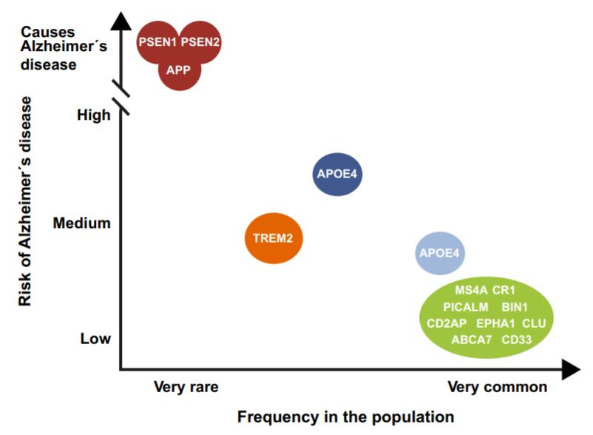
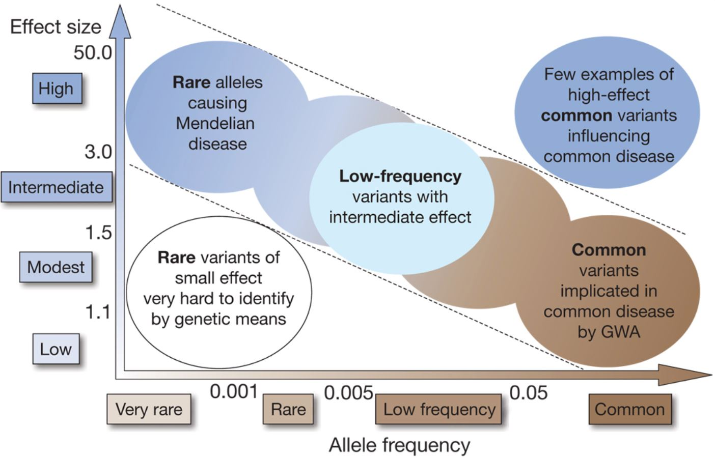
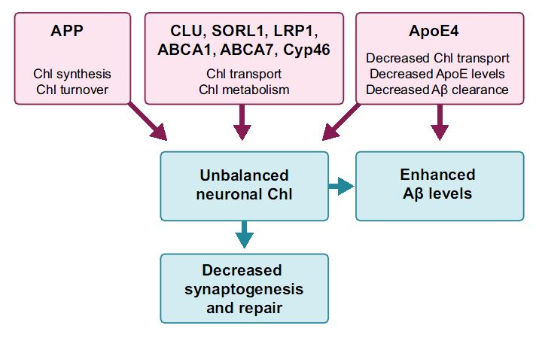
Bile acid + cholesterol (ABC transporters)
exome seq.
GWAS
Chol. is highly important for CNS (20%
of the body cholesterol is in the brain)
Smith–Lemli–Opitz sy etc. BBB closes postnat.
7-dehydrocholesterol reductase mut.
Manolio TA et al. (2009) Finding the missing heritability of complex diseases. Nature 461: 747-753; Hardy J et al. (2014) Pathways to Alzheimer’s disease. J Intern Med 275: 296-303; Štefulj J et al. (2013) Pathogenesis, modulation, and therapy of Alzheimer’s disease: a perspective on roles of liver-X receptors. Transl Neurosci 4: 349-356.

Slide 19
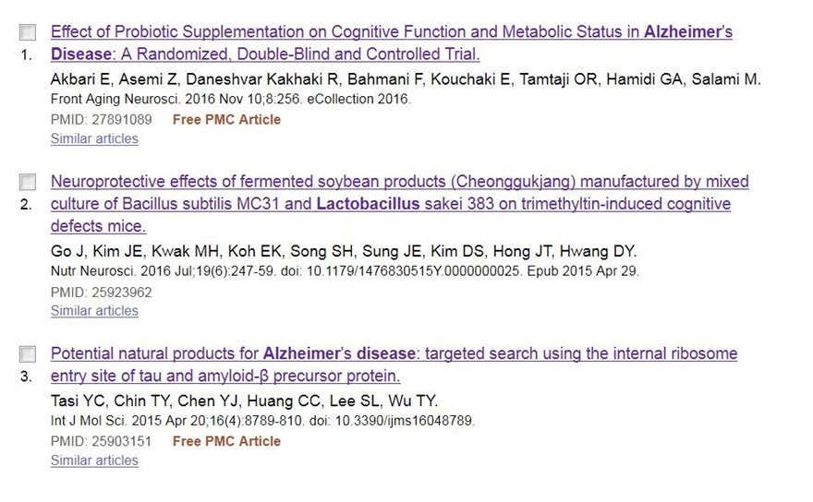
Lactobacillus and AD/cognitive f-ons
(Lactobacillus and depression = 116 studies with positive effects!)

Slide 20
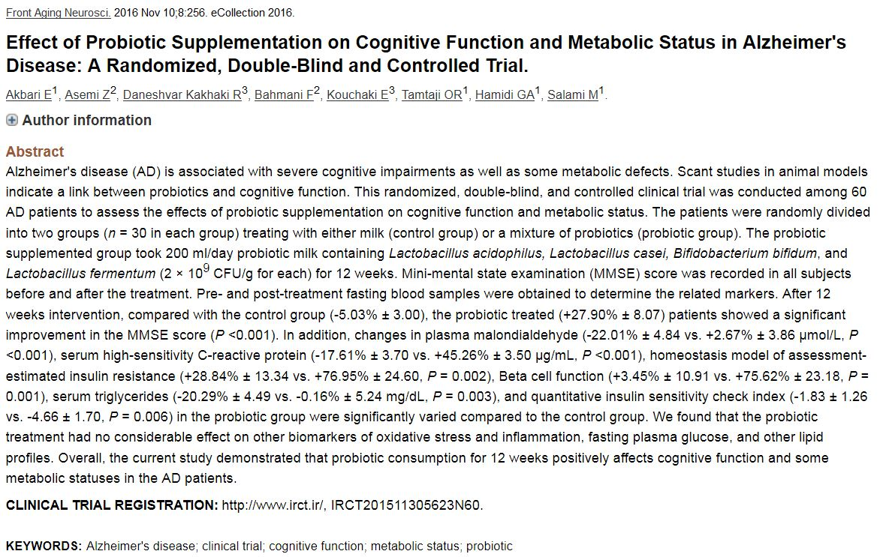
Lactobacillus and Alzheimer’s disease

Slide 21
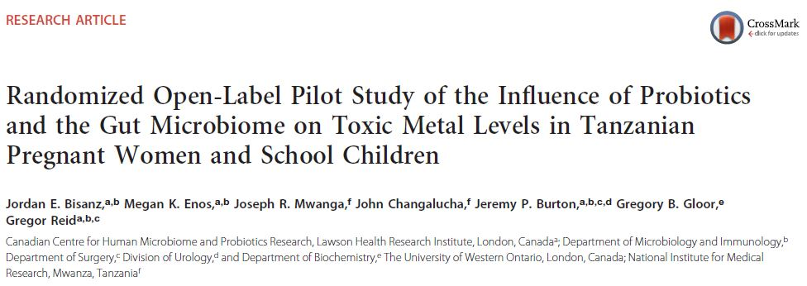
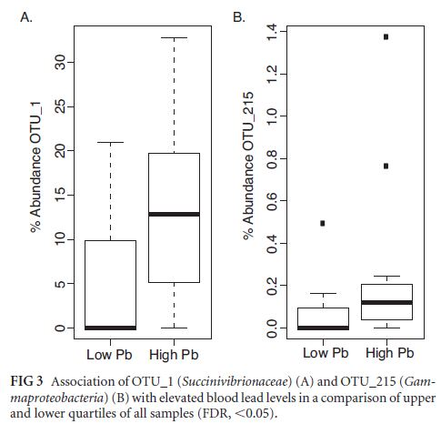
Probiotics and heavy metals levels
Am Soc Microbiol, 2015

Slide 22
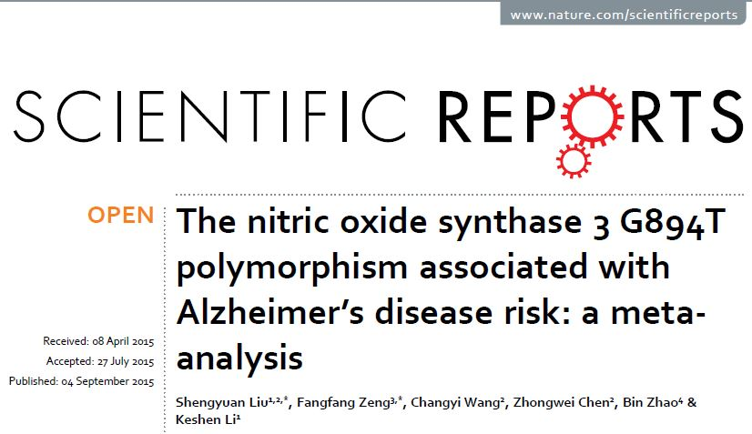
Nitric oxide synthase and AD
G894T polymorphism of NOS3 (endothelial NOS) is associated with AD susceptibility, especially late onset AD susceptibility

Slide 23
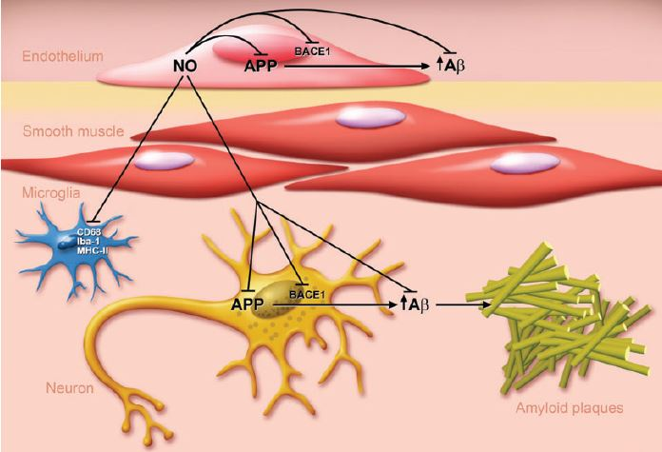
Nitric oxide synthase and AD
The loss of NO in cultured human cerebrovascular endothelium causes increased expression of APP and β-site APP-cleaving enzyme 1 (BACE1) thereby resulting in increased secretion of amyloid β peptides (Aβ1-40 and Aβ1-42). Furthermore, increased expression of APP and BACE1 as well as increased production of Aβ peptides was detected in the cerebral microvasculature and brain tissue of eNOS-deficient mice.
Katusic ZS et al. (2014) Eur Heart J 35: 888-894.

Slide 24
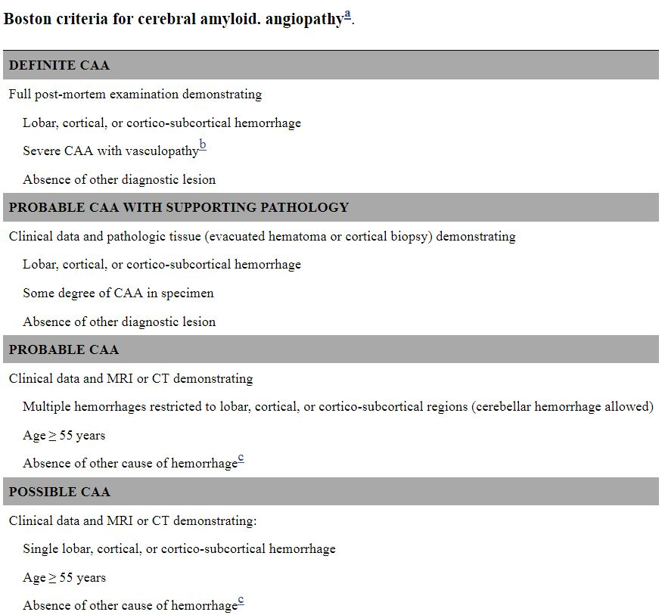
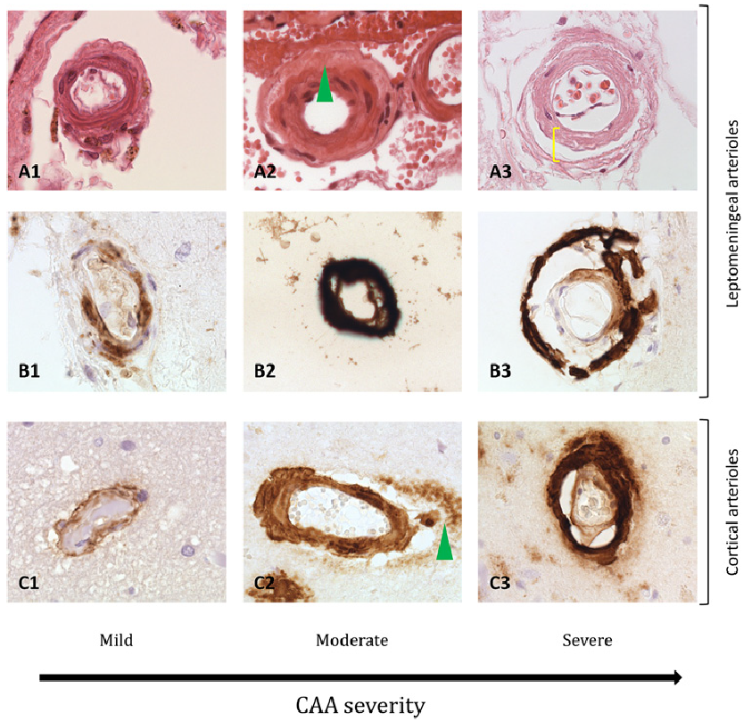
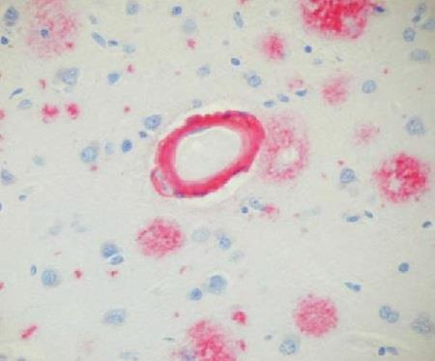
Cerebral amyloid angiopathy (CAA)
Charidimou et al., J. Neurol. Neurosurg. Psychiatry 2017
In advanced CAA, there are significant structural alterations, the most extreme of which is double barrelling (detachment and delamination of the
outer part of the tunica media)
amyloid deposition in the vessel wall
Knudsen et al., Neurology, 2001
amyloid deposition in the surrounding brain parenchima
(and not 1-40)
4G8
(with Aβ₁₋₄₂)

Slide 25
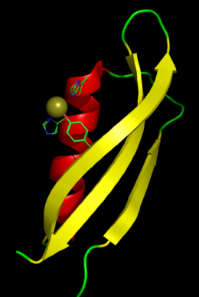
The 4 AI „hits” amend the Zlokovic’s concept of neurovascular unit breakdown in AD (Nat. Rev. Neurosci. 2011) and converge upon the „sealant hypothesis” of stroke and AD
a strong mechanism must exist in cerebral blood vessels that opposes clot formation even more than is the case in the periphery, to prevent stroke; so, prevention of cortical microbleeds and stroke by Aβ (as a sealant molecule) might represent an evolutionary adaptation of the amyloid precursor protein (APP) anticoagulant function in the CNS to serve as a stroke-preventing agent;
Cu

Slide 26
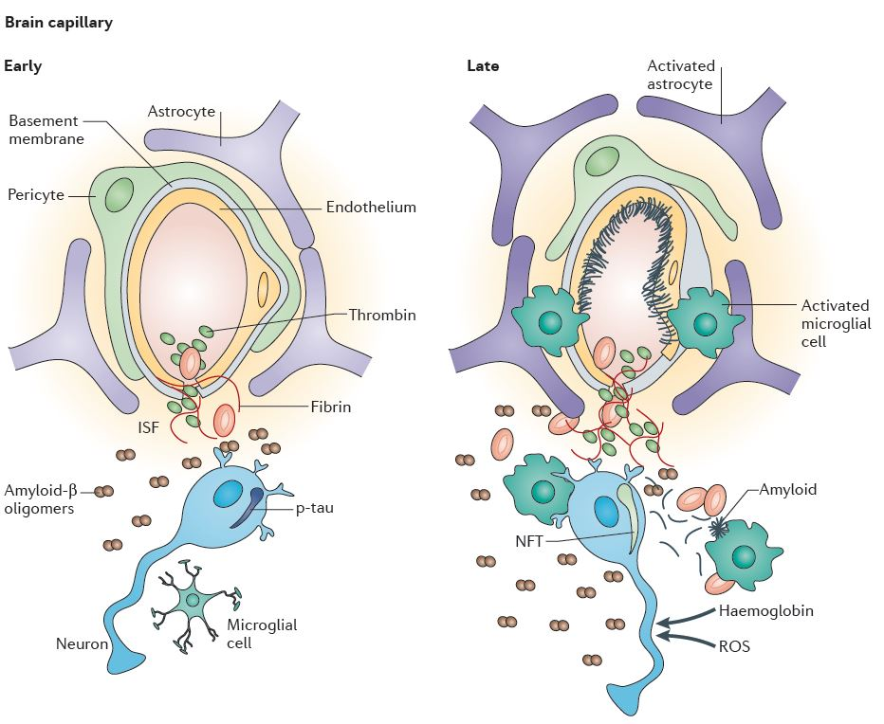
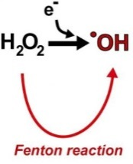
The 4 AI „hits” amend the Zlokovic’s concept of neurovascular unit breakdown in AD (Nat. Rev. Neurosci. 2011) and converge upon the „sealant hypothesis” of stroke and AD
- there may be no feedback signal or signalling pathway through which neurons receive the stop signal to cease creating Aβ by cleaving APP using the amyloidogenic pathway, neurons continue in AD to generate additional amounts of Aβ
Fe
- diminished Aβ clearance by the vascular smooth muscle cells, activation of M1 (proinflammatory) phenotype of microglial cells, which change the phenotype of astroglia to A1 -> foot processes become more permissive - > BBB breakdown
activation of MMPs
(also Zn²⁺ and Ca²⁺ –dependent), which are degrading ECM proteins
CAA and CMBs

Slide 27
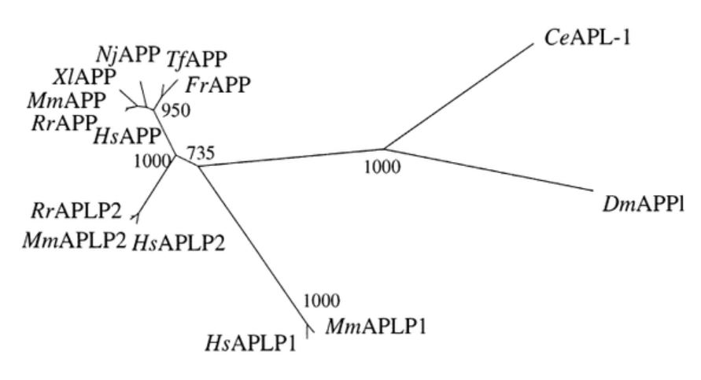
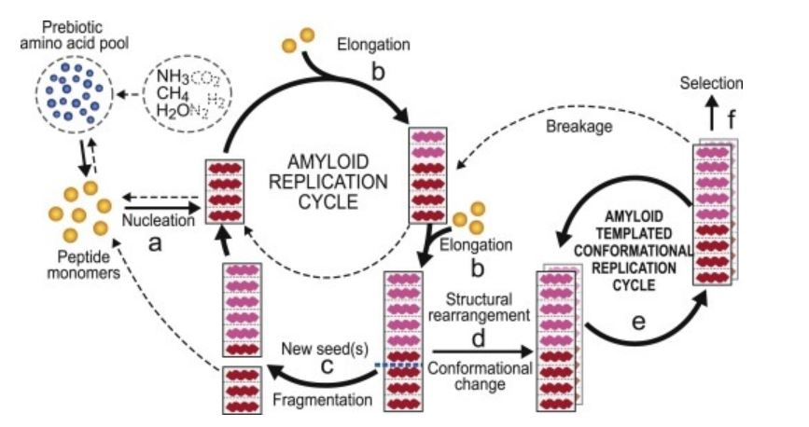
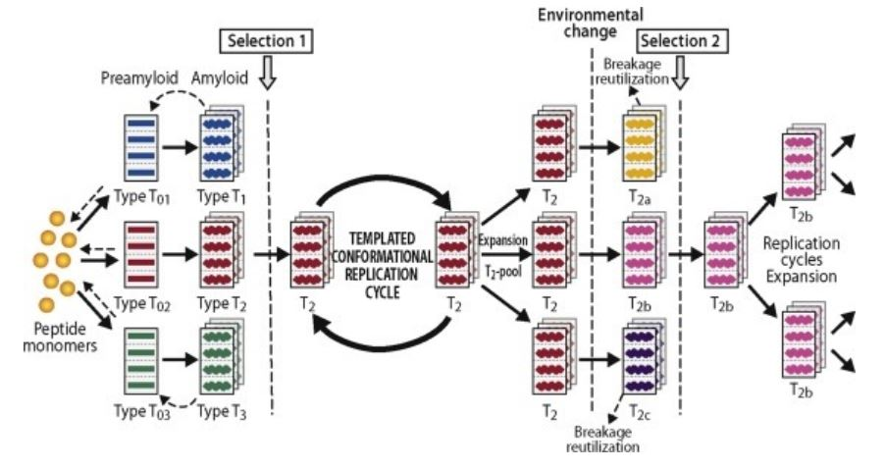
Some findings which speak in favor of a „sealant hypothesis”:
1. APP gene has been conserved for over 550 million years (so it must be doing something important): https://www.quora.com/What-is-the-evolutionary-history-of-amyloid-beta/answer/Jeffrey-Brender
Amyloid fibers can break with each
piece serving as a site for new growth.

Slide 28
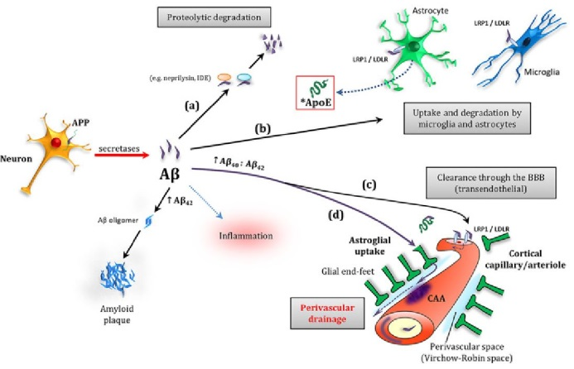
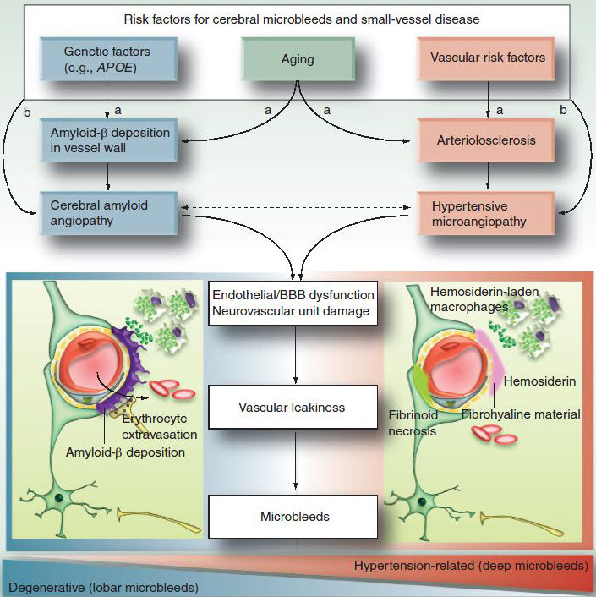
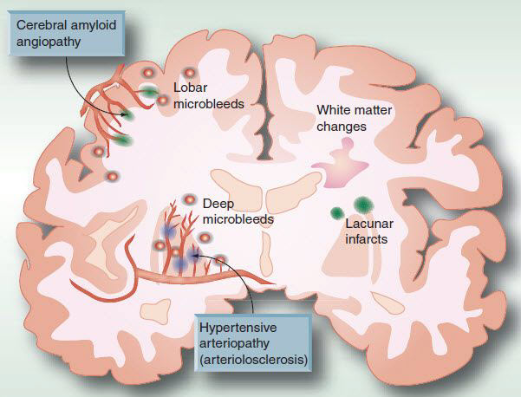
Findings which speak in favor of a „sealant hypothesis”:
2. Microhemorrhages were reported to preferentially occur in local regions of concentrated amyloid indicated by PiB (Pittsburgh compound B) retention (Dierksen et al., Ann. Neurol. 2010) and/or, reversely, highly co-localize with amyloid plaques in various mouse models of AD in 78-97%.

Slide 29
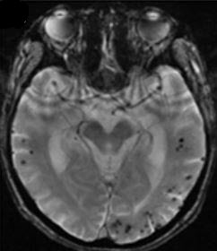
Findings which speak in favor of a „sealant hypothesis”:
3. There are three major isoforms of AβPP, two of which contain a domain homologous to Kunitz-type protease inhibitors (KPI). The secreted isoforms of AβPP containing the KPI domain are analogous to protease nexin-2 (PN-2). Both AβPP and PN-2 strongly inhibit coagulation factor XIa and are released from platelets and endothelial cells. They also inhibit activity of of factor IX (its role in hemostasis is underscored by the finding that individuals with a deficiency in this protein have spontaneous bleeding states of whom 12% have intracerebral hemorrhage).
GRE T2
Cortical microbleeds are larger than their actual size due to „booming” effect of hemosiderin
(highest in the occ. lobe)
Yamada, Front. Neurol. 2012

Slide 30
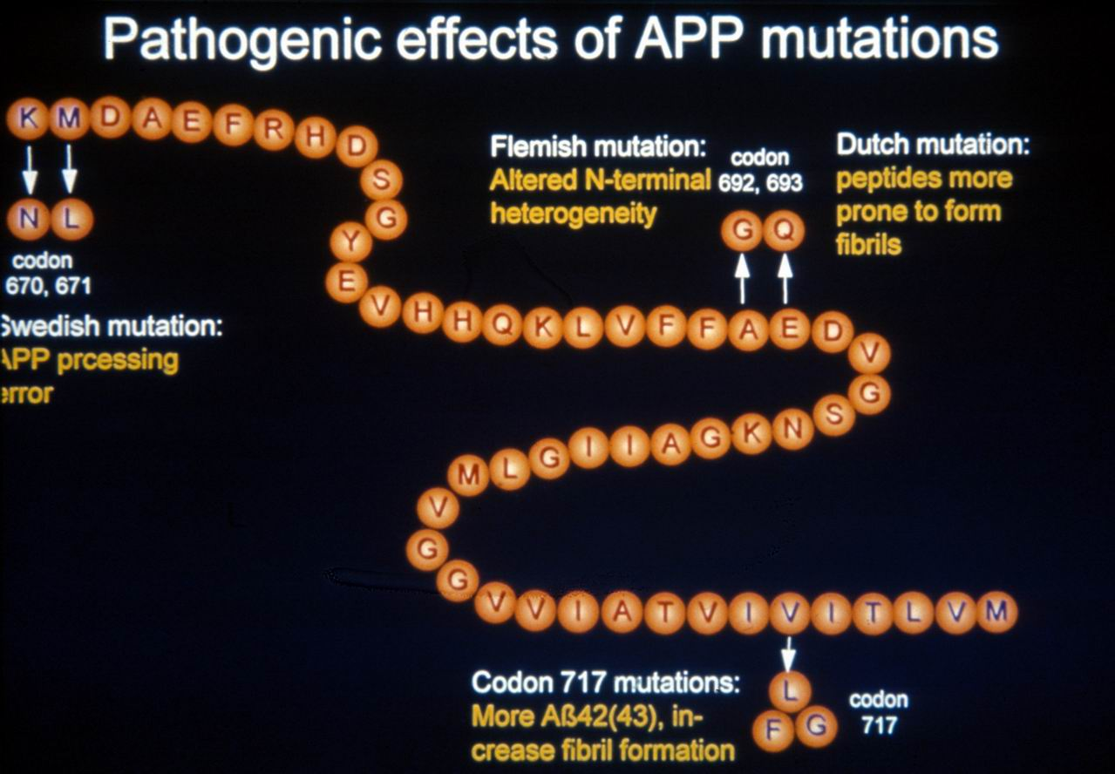
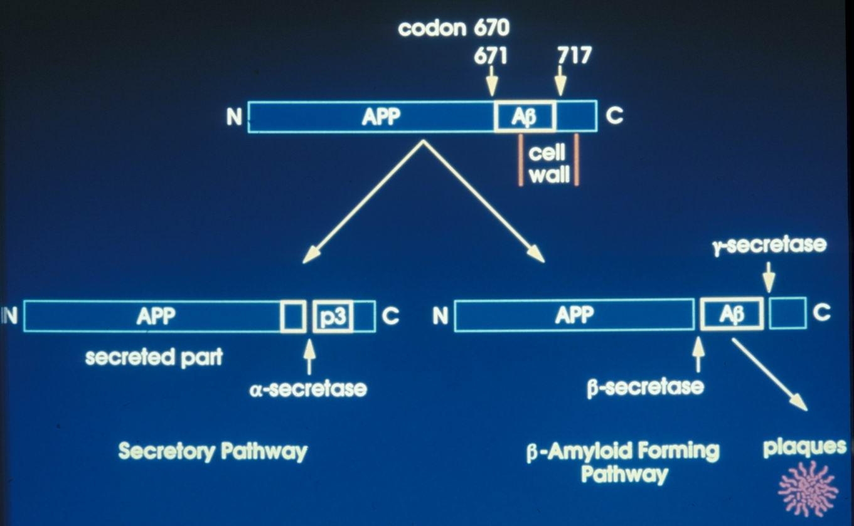
4. 2 out of five mutations in exons 16 and 17 of the APP gene, which encode part of the APP molecule from which later proteolytic cleavage by β- and γ-secretase will produce Aβ, cause fatal stroke in adulthood: the Flemish mutation (Cys692Gly) and the Italian mutation (Glu693Lys); however, two other mutations in the same region of the APP gene, are relatively less frequent and cause early AD: the Arctic mutation (Glu693Gly) and the Osaka mutation (Glu693Asp); the fifth mutation is protective leads to changes in APP structure near the cleavage point for γ-secretase which makes APP a weak substrate for cleavage by γ-secretase; consequently, people with this mutation have a lower likelihood of AD (Jonsson et al., 2012; confirmed by Kero et al., 2013).
HCHWA-D
London’s mutation
5. When production of Aβ (as a protective response) is prevented, as has been the case with the most ,if not all, clinical trials (immunization, BACE and γ-secretase inhibitors), there is always an increased likelihood for stroke to occur!

Slide 31
6. Notch 3 protein is one of the many substrates for γ-secretase.
For over 20 years, it has been known that mutations in NOTCH3 gene cause CADASIL (Cerebral Autosomal Dominant Arteriopathy with Subcortical Infarcts and Leukoencephalopathy).
Although rare cases of co-occurrence of CADASIL and AD have been reported, another strong link between AD and stroke has been discovered when

Slide 32
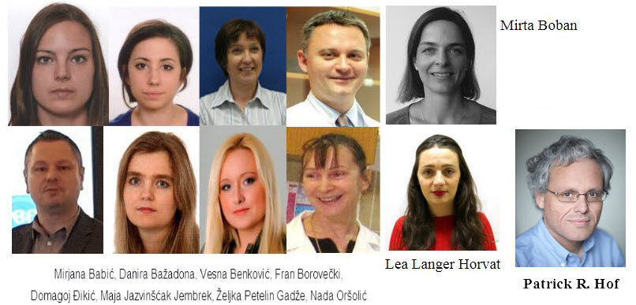
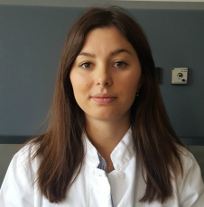
Collaborators:
Thank you for
your attention!
Visit our web page:
dementia.hiim.hr
Terezija Miškić
Croatian Science Foundation
IP-2014-09-9730 (2015-2019)

